Slide 1
CECS 323
Mimi Opkins

Slide 2
Introduction
Basic UML & SQL
Models
Classes & Schemes
Rows & Tables
Associations
Keys
SQL technique
SQL and RA
DDL & DML
Join
Multiple Joins
Join Types
Functions
Subqueries
Union & Minus
Views & Indexes
Check Constraints
UML design
Many-to-Many
Many-to-Many 2
Colliding Foreign Keys
Subkeys
Repeated Attributes
Multi-Valued Attributes
Domains
Enumerated Domains
Subclasses
Aggregation
Recursive Associations
Normalization
BCNF
Transactions
JDBC

Slide 3
Introduction
What is a database?
Why do we need one?
Avoid redundancy
duplication of information in multiple tables within a database
Data integrity
Refers to the validity of data
Referential Integrity
ensures that relationships between tables remain consistent
Deletion Anomalies
Deletion of one row of a table results in the deletion of unintended information

Slide 4
Different Types of Databases
Paper
Flatfile
Hierarchical
Network
Relational
Object

Slide 5
Introduction – Redundancy
The duplication of information in multiple tables within a database
Ex. School Records may all have info about you
Admissions
Enrollment Services
Department
Student Union

Slide 6
Introduction – Data Integrity
Refers to the validity of data.
Data integrity can be compromised in a number of ways:
Human errors when data is entered
Errors that occur when data is transmitted from one computer to another
Software bugs or viruses
Hardware malfunctions, such as disk crashes
Natural disasters, such as fires and floods

Slide 7
Introduction – Referential Integrity
Referential integrity ensures that relationships between tables remain consistent.
When one table has a foreign key to another table, the concept of referential integrity states that you may not add a record to the table that contains the foreign key unless there is a corresponding record in the linked table.
It also includes the techniques known as cascading update and cascading delete, which ensure that changes made to the linked table are reflected in the primary table.

Slide 8
Introduction – Anomalies
An anomaly is an inconsistent, incomplete, or contradictory state of the database
Insertion anomaly – user is unable to insert a new record when it should be possible to do so
Deletion anomaly – when a record is deleted, other information that is tied to it is also deleted
Update anomaly –a record is updated, but other appearances of the same items are not updated

Slide 9
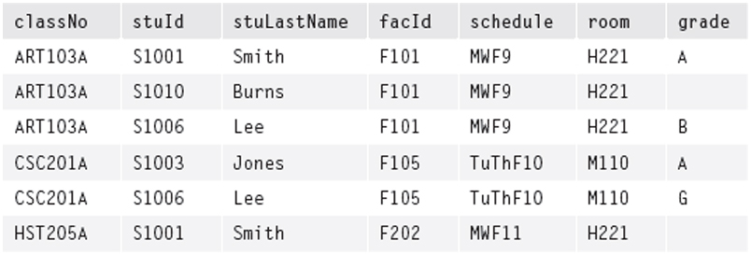
Anomaly Examples: NewClass Table
NewClass(courseNo, stuId, stuLastName, fID, schedule, room, grade)
Figure 6.1 The NewClass Table

Slide 10
Anomaly Examples: NewClass Table
Update anomaly: If schedule of ART103A is updated in first record, and not in second and third – data is inconsistent
Deletion anomaly: If record of student S1001 is deleted, information about HST205A class is lost also
Insertion anomaly: It is not possible to add a new class, for MTH101A , even if its teacher, schedule, and room are known, unless there is a student registered for it, because the key contains stuId

Slide 11
Introduction – Relational Database
What is a relational database?
Based on Relational Algebra
Tables and their relationships to each other
Easily navigated
Popular
Standard query language
Familiar Concepts

Slide 12
Models and Languages
Database design is a process of modeling an enterprise in the real world.
A database itself is a model of the real world that contains selected information needed by the enterprise.
There are many models and languages used for this modeling. Some of these are mathematically based. Others are less formal and more intuitive.

Slide 13
Unified Modeling Language (UML)
The Unified Modeling Language (UML) was designed for software engineering of large systems using object-oriented (OO) programming languages.
UML is a very large language; we will use only a small portion of it here, to model those portions of an enterprise that will be represented in the database.
It is our tool for communicating with the client in terms that are used in the enterprise.
Used to describe the conceptual view of a database.

Slide 14
Entity-Relationship (ER)
The Entity-Relationship (ER) model is used in many database development systems.
There are many different graphic standards that can represent the ER model. Some of the most modern of these look very similar to the UML class diagram, but may also include elements of the relational model.

Slide 15
Relational Model (RM)
The Relational Model (RM) is the formal model of a database that was developed for IBM in the early 1970s by Dr. E.F. Codd.
It is largely based on set theory, which makes it both powerful and easy to implement in computers.
All modern relational databases are based on this model.
We will use it to represent information that does not (and should not) appear in the UML model but is needed for us to build functioning databases.

Slide 16
Relational Algebra (RA)
Relational Algebra (RA) is a formal language used to symbolically manipulate objects of the relational model.
Terms used to refer to the logical view of the database.

Slide 17
Table Model
The table model is an informal set of terms for relational model objects. These are the terms used most often by database developers.
Terms used to refer to the physical view of the database.

Slide 18
Structured Query Language (SQL)
The Structured Query Language (SQL, pronounced sequel or ess-que-ell) is used to build and manipulate relational databases.
It is based on relational algebra, but provides additional capabilities that are needed in commercial systems.
It is a declarative, rather than a procedural, programming language.
There is a standard for this language, but products vary in how closely they implement it.

Slide 19
Basic Structures: Classes and Schemes – UML Class
UML class (ER term: entity) is anything in the enterprise that is to be represented in our database
The first step in modeling a class is to describe it in natural language.
Example: build a sales database. Let’s start by defining customer using natural language.
Attribute (properties) is a piece of information that characterizes each member of a class
Descriptive attributes (natural attribute) are those which actually provide real-world information about the class.
UML only uses descriptive attributes
ID number are not descriptive attributes

Slide 20
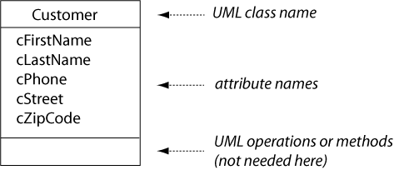
Basic Structures: Classes and Schemes – Class Diagram
A class diagram shows the class name and list of attributes that identify data elements we need to know about each member (instance, occurrence, of a class)
The Customer class represents any person who has done business with us or who we think might do business with us in the future. Its attributes are:
Customer first name.
Customer last name.
Customer phone.
Customer street.
Customer zip code.

Slide 21
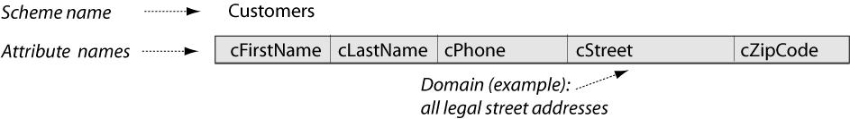
Basic Structures: Classes and Schemes – Relation Scheme
In an OO programming language, each class is instantiated with objects of that class. In building a relational database, each class is first translated into a relation model scheme. The scheme starts with all of the attributes from the class diagram.
The Customers relation scheme attributes are:
Customer first name, a person's first name.
Customer last name, a person's last name.
Customer phone, a valid telephone number.
Customer street, a street address.
Customer zip code, a zip code designated by the United States Postal Service.

Slide 22
Basic Structures: Classes and Schemes – Sets
In the relational model, a scheme is defined as a set of attributes, together with an assignment rule that associates each attribute with a set of legal values that may be assigned to it. These values are called the domain of the attribute.
Customers Scheme = {cFirstname, cLastname, cPhone, cStreet, cZipCode}.
It’s important to recognize that defining schemes or domains as sets of something automatically tells us a lot more about them:
They cannot contain duplicate elements.
The elements in them are unordered.
We can develop rules for what can be included in them and what is excluded from them. For example, zip codes don’t belong in the domain (set) of phone numbers, and vice-versa.
We can define subsets of them—for example, we can display only a selected set of attributes from a scheme, or we can limit the domain of an attribute to a specific range of values.
They may be manipulated with the usual set operators (union, intersection).

Slide 23
Basic Structures: Classes and Schemes – Table Structure
When we actually build the database, each relation scheme becomes the structure of one table.
CREATE TABLE customers (
cfirstname VARCHAR(20) NOT NULL, clastname VARCHAR(20) NOT NULL, cphone VARCHAR(20) NOT NULL,
cstreet VARCHAR(50),
czipcode VARCHAR(5));

Slide 24
Basic Structures: Classes and Schemes – Data Models
Conceptual
Logical
Physical

Slide 25
Basic Structures: Rows and Tables - Definitions
Each real-world individual of a class is represented by a row of information in a database table.
The row is defined in the relational model as a tuple that is constructed over a given scheme.
Mathematically, the tuple is a function that assigns a constant value from the attribute domain to each attribute of the scheme. Since the scheme is really a set of attributes, order is not important.

Slide 26
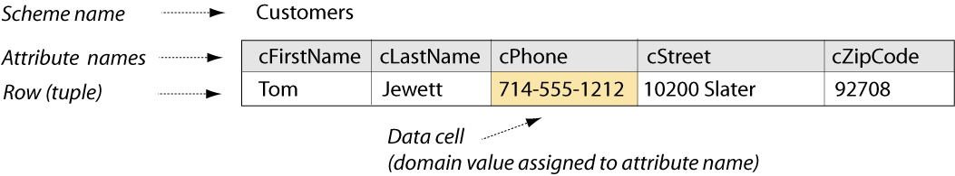
Basic structures: Rows and Tables – Assignment
Each attribute of the Customers scheme is assigned a value from its domain:
Customer first name is assigned the value "Tom", from the domain of people's first names.
Customer last name is assigned the value "Jewett", from the domain of people's last names.
Customer phone is assigned the value "714-555-1212", from the domain valid telephone numbers.
Customer street is assigned the value "10200 Slater", from the domain of street addresses.
Customer zip code is assigned the value "92708", from the domain of zip codes designated by the United States Postal Service.
Each of the assignments results in a data cell of the row or tuple.

Slide 27
Sneak Peak - Atomicity
Looking at the previous example, you may be tempted to gloss over the simple fact that each tuple has one and only one value for a given attribute.
That’s actually quite important. We will see that the database management system supports long strings, and we, for our part can cram more than one value into those (MDC Huntington Beach example here), but that violates the intent of the relational paradigm.

Slide 28
Basic Structures: Rows and Tables – Formal Notation
In formal notation, we could show the assignments explicitly, where t represents a tuple:
tTJ = ‹cfirstname := 'Tom', clastname := 'Jewett', cphone := '714-555-1212', cstreet := '10200 Slater', czipcode := '92708'›
Database:
INSERT INTO customers (cfirstname, clastname, cphone, cstreet, czipcode) VALUES ('Tom', 'Jewett', '714-555-1212', '10200 Slater', '92708');
UPDATE customers SET cphone = '714-555-2323' WHERE cphone = '714-555-1212';

Slide 29
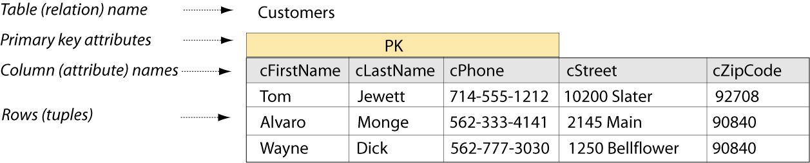
Basic Structures: Rows and Tables - Database
A database table is simply a collection of zero or more rows. This follows from the relational model definition of a relation as a set of tuples over the same scheme. Order is not important.
Additional rows are built on the Customers scheme as before. The table or relation consists of all rows.
Three of the attributes in the Customers scheme are now identified as the primary key, which is explained later on.

Slide 30
Basic Structures: Rows and Tables - Tuples
Knowing that the relation (table) is a set of tuples (rows) tells us more about this structure, as we saw with schemes and domains.
Each tuple/row is unique; there are no duplicates
Tuples/rows are unordered; we can display them in any way we like and the meaning doesn’t change. (SQL gives us the capability to control the display order.)
Tuples/rows may be included in a relation/table set if they are constructed on the scheme of that relation; they are excluded otherwise. (It would make no sense to have an Order row in the Customers table.)
We can define subsets of the rows by specifying criteria for inclusion in the subset. (Again, this is part of a SQL query.)
We can find the union, intersection, or difference of the rows in two or more tables, as long as they are constructed over the same scheme.

Slide 31
Basic Structures: Rows and Tables – Insuring Unique Rows
Each row in a table must be distinct. So there must be a set of attributes in each relation that guarantee uniqueness. Any set of attributes that can do this is called a super key of the relation.
The database designer picks of the possible super key sets to serve as the primary key or unique identifier of each row.

Slide 32
Basic Structures: Rows and Tables – Super Keys
cfirstname,clastname,cphone,cstreet,czipcode
cfirstname,clastname,cphone,cstreet
cfirstname,clastname,cphone,czipcode
cfirstname,clastname,cstreet,czipcode
cfirstname,clastname,cphone
cfirstname,clastname,cstreet
Note that at the very least, all of the attributes of a given scheme must be a superkey, otherwise it is not a valid scheme.

Slide 33
Basic Structures: Rows and Tables – Insuring Unique Rows - SQL
Using two SQL statements:
CREATE TABLE customers (
cfirstname VARCHAR(20) NOT NULL,
clastname VARCHAR(20) NOT NULL,
cphone VARCHAR(20) NOT NULL,
cstreet VARCHAR(50),
czipcode VARCHAR(5));
ALTER TABLE customers
ADD CONSTRAINT customers_pk
PRIMARY KEY (cfirstname, clastname, cphone);

Slide 34
Basic Structures: Rows and Tables – Insuring Unique Rows - SQL
Using one SQL Statement:
CREATE TABLE customers (
cfirstname VARCHAR(20) NOT NULL,
clastname VARCHAR(20) NOT NULL,
cphone VARCHAR(20) NOT NULL,
cstreet VARCHAR(50),
czipcode VARCHAR(5)),
CONSTRAINT customers_pk
PRIMARY KEY (cfirstname, clastname, cphone);

Slide 35
Basic Structures: Associations – The UML Association
UML association (ER term: relationship) is the way that two classes are functionally connected to each other.
Example: relationship between customers and orders in a sales database. First define orders then define the relationship.
UML multiplicity (ER term: cardinality) how few (at minimum) and how many (at maximum) individuals of one class may be connected to a single individual of the other class.

Slide 36
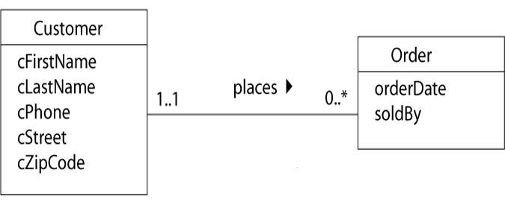
Basic structures: Associations – Class Diagram
One customer places zero to many orders
One order is placed by one and only one customer

Slide 37
Basic structures: Associations – Class Diagram Data Dictionary
The Customer class represents any person who has done business with us or who we think might do business with us in the future. Its attributes are:
Customer first name.
Customer last name.
Customer phone.
Customer street.
Customer zip code.
The Order class represents an event that happens when a customer decides to buy one or more of our products. Its attributes are:
Order date.
Sold by, which identifies the sales person.
The association between customer and order classes is:
Each customer places zero or more orders.
Each order is placed by one and only one customer.

Slide 38
Basic Structures: Associations – Class Diagram Description
Looking at the maximum multiplicity at each end of the line (1 and * here), we call this a one-to-many association.
The UML representation of the Order class contains only its own descriptive attributes. The UML association tells which customer placed an order.
In the database, we will need a different way to identify the customer; that will be part of the relation scheme.

Slide 39
Basic Structures: Associations – Relation Scheme
The relation scheme for the new Orders table contains all of the attributes from the class diagram as before. But we also need to represent the association in the database – which customer placed each order. This is done by copying the PK attributes of the Customer into the Orders scheme.
The copied attributes are called a foreign key.

Slide 40
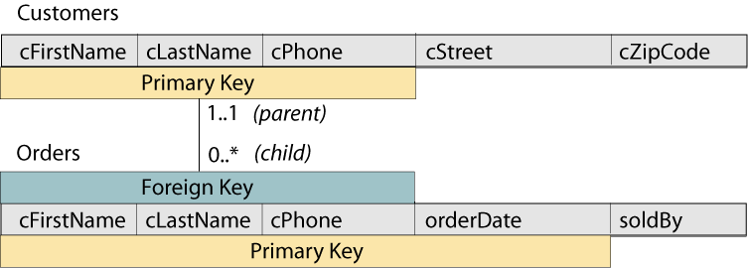
Basic Structures: Associations – Relation Scheme Diagram

Slide 41
Basic Structures: Associations – Identifying Relationship
Note that in the previous diagram, the three migrating foreign key attributes are all included in the key of the child.
The way to think about this is that we need to know the customer who placed the order and the order date in order to identify the order.
It is important to regard the migrating foreign key attributes as a package. You cannot just put some of them in the primary key of the child.
As you have probably already guessed, if Orders has a child, that association will migrate four primary keys attributes.
Notes:
There are those who criticize ER modeling because it exposes the implementation of the association by explicitly modeling the migrating foreign keys. UML, by contrast, does not speak to the harsh reality of how that association is actually implemented and thus is more conceptual in nature.

Slide 42
Basic structures: Associations – Relation Scheme Data Dictionary
The Customers relation scheme attributes are:
Customer first name, a person's first name.
Customer last name, a person's last name.
Customer phone, a valid telephone number.
Customer street, a street address.
Customer zip code, a zip code designated by the United States Postal Service.
The primary key attributes of the Customers relation are the first name, last name, and phone.
The Orders relation scheme attributes are:
Customer first name, foreign key from Customers.
Customer last name, foreign key from Customers.
Customer phone, foreign key from Customers.
Order date, a calendar date possibly with the clock time.
Sold by, the first name of the sales person taking the order.
The primary key attributes of the Orders relation are the three foreign key attributes plus the order date.

Slide 43
Identifying vs. non-identifying
In the previous example, to properly identify the order, we need to know who placed the order.
But consider a different scenario – identifying the owner of a vehicle.
The vehicle is identified, not by the owner, but by the Vehicle Identification Number (VIN).
The owner of the vehicle is merely another attribute of the vehicle.
In fact, the vehicle has a VIN in advance of anyone purchasing the vehicle initially, so there is no existential dependency of the vehicle on the owner.

Slide 44
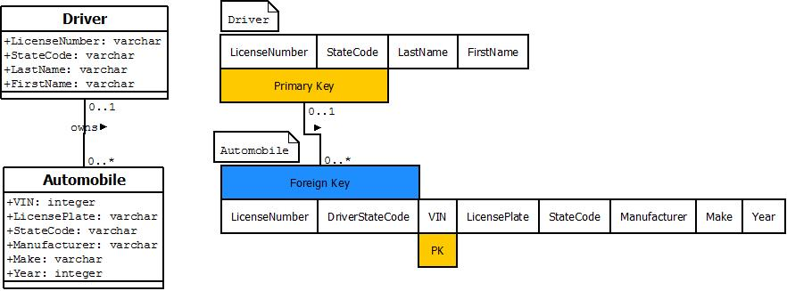
Let’s see that in pictures
Note that the minimum cardinality is zero at both ends of this relationship.
A driver could exist in the DMV database without any registered vehicles
A vehicle can exist without any driver for it at some point in time.

Slide 45
Adding the Foreign Key Constraint
To make sure that we never assign an invalid owner to a given vehicle, we impose the constraint that the owner has to be found in the driver table:
ALTER TABLE AUTOMOBILE
ADD CONSTRAINT automobile_driver_fk_01
FOREIGN KEY (LicenseNumber, DriverStateCode) REFERENCES DRIVER (LicenseNumber, StateCode);
Note that the StateCode migrates into an attribute called DriverStateCode to distinguish it from the statecode associated with the automobile itself.
Notes:
Note that I use an alter table statement here strictly for the sake of real estate on the foil. It is far better to include the foreign key constraint in the create table statement for the same reasons that we want to try to include the primary key constraint in the create table statement.

Slide 46
Basic Structures: Associations – Relation Scheme Description
Since we can’t have an order without a customer, we call Customers the parent and Orders the child scheme in this association.
The “one” side of an association is always the parent, and provides the PK attributes to be copied.
The “many” side of an association is always the child, into which the FK attributes are copied.
Memorize it: one, parent, PK; many, child, FK.
An FK might or might not become part of the PK of the child relation into which it is copied. In this case, it does, since we need to know both who placed an order and when the order was placed in order to identify it uniquely.

Slide 47
Basic Structures: Associations – The Child Table
CREATE TABLE orders (
cfirstname VARCHAR(20) NOT NULL,
clastname VARCHAR(20) NOT NULL,
cphone VARCHAR(20) NOT NULL,
orderdate DATE NOT NULL,
soldby VARCHAR(20));
The FK attributes must be exactly the same data type and size as in the PK table
In some DBMS, DATE is both Date and Time
Note that the migrated foreign key attributes must be not null because the relationship is identifying.

Slide 48
Basic Structures: Associations – Uniqueness
To ensure that every row of the Orders table is unique, we need to know both who the customer is and what day (and time) the order was placed.
We specify all of these attributes as the pk:
ALTER TABLE orders
ADD CONSTRAINT orders_pk
PRIMARY KEY (cfirstname, clastname, cphone, orderdate);

Slide 49
Basic Structures: Associations –Referential Integrity
In addition, we need to identify which attributes make up the FK, and where they are found as a PK. The FK constraint will insure that every order contains a valid customer name and phone number—this is called maintaining the referential integrity of the database.
ALTER TABLE orders
ADD CONSTRAINT orders_customers_fk
FOREIGN KEY(cfirstname, clastname, cphone)
REFERENCES customers (cfirstname, clastname, cphone);

Slide 50
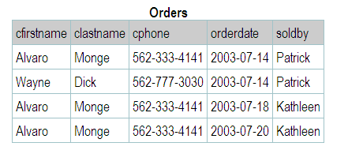
Basic Structures: Associations – The Orders Table

Slide 51
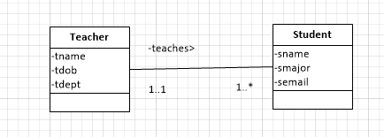
Another Example
Let’s limit this enterprise to consider the relationship between a University instructor and the students in one class

Slide 52
Class Definitions
A teacher is a person that instructs students taking courses to learn.
A student is someone enrolled in classes to receive an education.

Slide 53
Relationship Definitions
One teacher teaches one to many students.
One student is taught by one and only one teacher.

Slide 54
Primary Key
For the primary key of Teacher, use tname and tdob.
Copy these PK attributes from the parent (Teacher) to the child (Student) and mark them as Foreign Keys.
Question: does a Student need a Teacher to be unique? No, the email itself can be used as the PK of the student.
This is an example of when the PK of the parent is NOT part of the PK of a child.

Slide 55
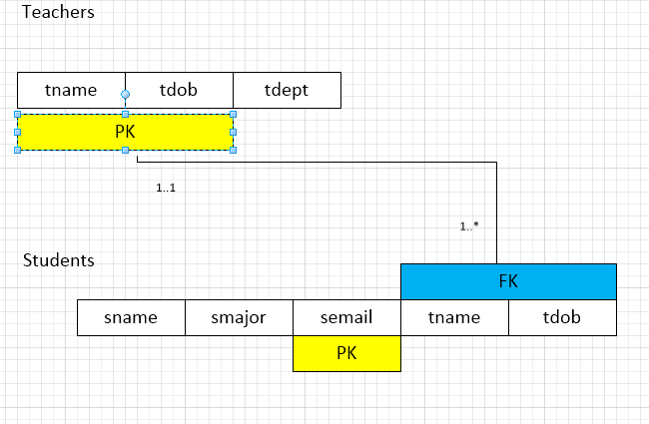
Relation Scheme

Slide 56
SQL
Even though in this example, the FK of the parent does not become part of the PK of the child, the Students table still needs to have the FK attributes as part of the table and a FK constraint must still be created.

Slide 57
CREATE TABLE teachers (
tname VARCHAR(20) NOT NULL,
tdept VARCHAR(20) NOT NULL,
tdob DATE NOT NULL);
ALTER TABLE teachers
ADD CONSTRAINT teachers_pk
PRIMARY KEY (tname,tdob);

Slide 58
Students Table
CREATE TABLE students (
tname VARCHAR(20) NOT NULL,
tdob DATE NOT NULL,
sname VARCHAR(20) NOT NULL,
smajor VARCHAR(20) NOT NULL,
semail VARCHAR(90) NOT NULL);
ALTER TABLE students
ADD CONSTRAINT students_pk
PRIMARY KEY (semail);
ALTER TABLE students
ADD CONSTRAINT students_teachers_fk
FOREIGN KEY (tname,tdob)
REFERENCES teachers (tname,tdob);

Slide 59
Discussion: More About Keys

Slide 60
Discussion: More About Keys – Super Key
Remember that a super key is any set of attributes whose values, taken together, uniquely identify each row of a table—and that a primary key is the specific super key set of attributes that we picked to serve as the unique identifier for rows of this table.
We are showing these attributes in the scheme diagram for convenience, understanding that keys are a property of the table (relation), not of the scheme.

Slide 61
Discussion: More About Keys – Candidate Keys
Before picking the PK, we need to identify any candidate key or keys that we can find for the table. A CK is a minimal super key. Minimal means that if you take away any one attribute from the set, it is no longer a super key.
If you add one attribute to the set, it is no longer minimal but it’s still a super key. The word “candidate” simply means that this set of attributes could be used as the primary key.
Whether a set of attributes constitutes a CK or not depends entirely on the data in the table – not just on whatever data happens to be in the table at that moment but on any set of data that could be realistically be in the table over the life of the database.
Does the set {cFirstName,cLastName,cPhone} meets the test. If not, what other attributes might we need in the table to make a candidate key?

Slide 62
Discussion: More About Keys – PK Size Might Matter
Copying three attributes from the parent table to the child table each time a child record is created can be a lot of data even if we have a valid candidate key. It may make sense to “make up” a PK that is small enough. There are two types of “made up” PKs:
surrogate PK – a single, small attribute (such as a number) that has no descriptive value such as an id number
substitute PK – a single, small attribute (such as an abbreviation) that has at least some descriptive value.

Slide 63
Discussion: More About Keys – Surrogate/Substitute Keys
Do not automatically add surrogate or substitute keys to a table until you are sure that
there is at least one candidate key before the surrogate is added
the table is a parent in at least one association
there is no candidate key small enough for its values to be copied many times into the child table
external key – a surrogate or substitute key already defined by someone else such as a zip code, UPC, ISBN
Only use a Social Security Number as a NON-KEY field if required by law

Slide 64
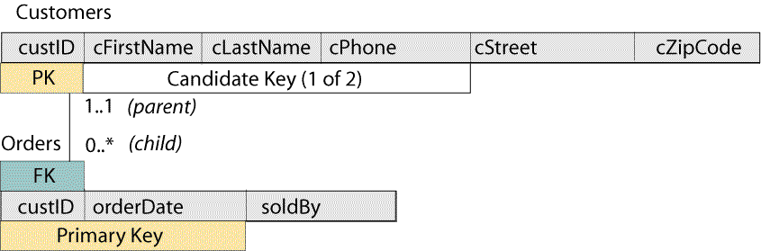
Discussion: More About Keys – Revising the Relation Scheme

Slide 65
Candidate Key Enforcement
Remember from lab that when you create a primary key, the database automatically creates what is called a backing index on the columns in the primary key to enforce uniqueness.
The candidate key is more than just a concept, it is a constraint on the data.
Therefore, each candidate key that you model must be declared to the database in the form of a uniqueness constraint which will, in turn, cause the database to create a unique index for the candidate key.

Slide 66
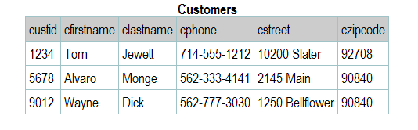
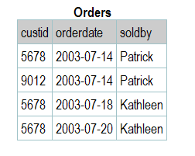
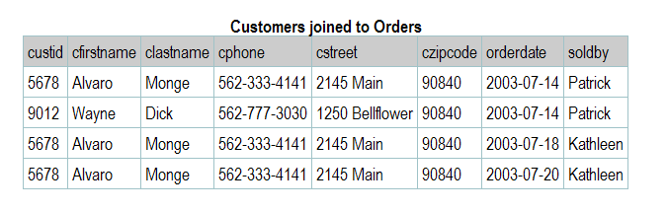
Discussion: More About Keys –Customer Joined to Orders

Slide 67
Design Pattern: Many-to-Many (Order Entry)
Design patterns are modeling situations that you will find over and over again as you design real databases. These become tools that you use constantly use to build enterprise models.
The sales database represents one of these design patterns called “many-to-many.” In order to complete the pattern we need products to sell.

Slide 68
Design Pattern: Many-to-Many (Order Entry)–Finishing the Pattern
Define the product
Define the relationship between orders and products
Define the need for orderlines
Since the maximum multiplicity in each direction is “many,” this is called a many-to-many association between Orders and Products.
Each time an order is placed for a product, we need to know how many units of that product are being ordered and what price we are actually selling the product for. These attributes are a result of the association between the Order and the Product. We show them in an association class that is connected to the association by a dotted line.

Slide 69
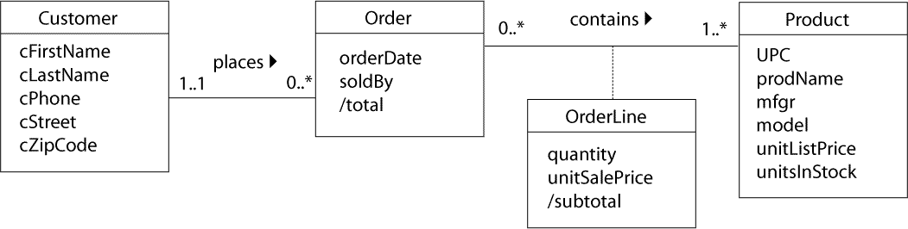
Design Pattern: Many-to-Many (Order Entry) – Class Diagram

Slide 70
Modeling Style Note
There are those modelers who would argue that if you don’t have anything to put into the association class, then leave the class out.
I will insist that you show the association class every time you have a many to many relationship without fail:
It is there as a reminder in case association class attributes and/or associations to/from the association class emerge later
It makes mapping the conceptual model into the physical model easier because the association class materializes as the junction table.

Slide 71
Design Pattern: Many-to-Many (Order Entry) – Junction Table
We can’t represent a many-to-many association directly in a relation scheme, because two tables can’t be children of each other—there’s no place to put the foreign keys. So for every many-to-many, we will need a junction table in the database, and we need to show the scheme of this table in our diagram.

Slide 72
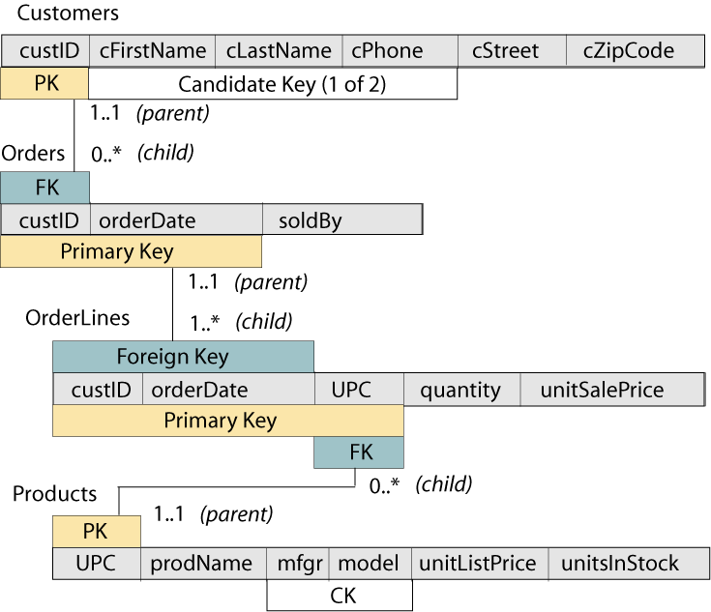
Design Pattern: Many-to-Many (Order Entry) – Relation Scheme

Slide 73
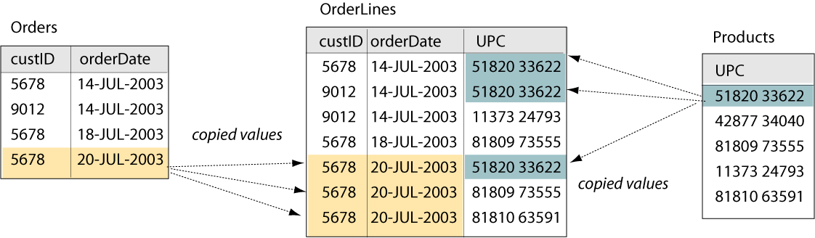
Design Pattern: Many-to-Many (Order Entry) – Data Representation

Slide 74
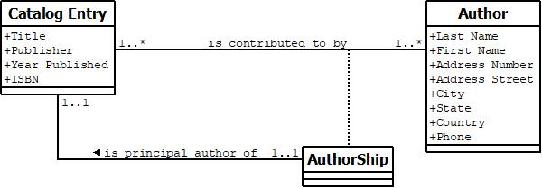
Many to Many “loopback”
We want just one of the authors designated as the principal author.
We want to treat the principal author the same way that we do any other.
Notes:
An early example of colliding foreign key. Do the relation scheme diagram on the white board.

Slide 75
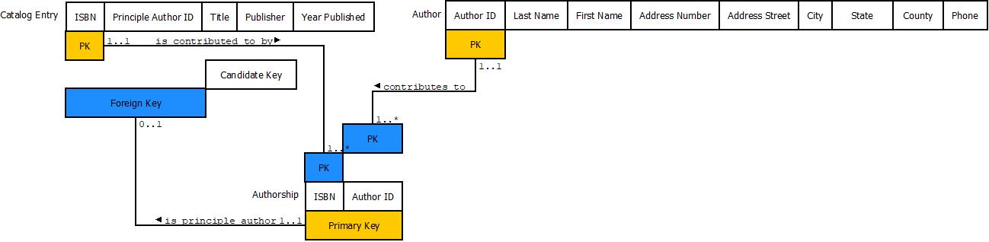
The Relation Scheme Diagram
The ISBN in Authorship comes back into Catalog Entry and must have the same value.
This is what I call Foreign Key collision, and we will see this pattern come up over and over.

Slide 76
Design Pattern: Many-to-Many With History (the Library Loan)
There are times when we need to allow the same two individuals in a many-to-many association to be paired more than once. This frequently happens when we need to keep a history of events over time.
Example: In a library, customers can borrow many books and each book can be borrowed by many customers, so this seems to be a simple many-to-many association between customers and books. But any one customer may borrow a book, return it, and then borrow the same book again at a later time. The library records each book loan separately; there is no invoice for each set of borrowed books (that is, there is no equivalent here of the Order in the order entry example).

Slide 77
Design Pattern: Many-to-Many With History (the Library Loan) – Classes
The loan is an event that happens in the real world. We need a regular class to model it correctly. We’ll call this the “library loan” design pattern. First, we need to understand what the classes and associations mean:
“A customer is any person who has registered with the library and is eligible to check out books.”
“A catalog entry is essentially the same as an old-fashioned index card that represents the title and other information about books in the library, and allows the customers to quickly find a book on the shelves.”
“A book is the physical volume that is either sitting on the library shelves or is checked out by a customer. There can be many physical books represented by any one catalog entry.”
“A loan event happens when one customer takes one book to the checkout counter, has the book and her library card scanned, and then takes the book home to read.”

Slide 78
Design Pattern: Many-to-Many With History (the Library Loan)-Associations
“Each Customer makes zero or more Loans.”
“Each Loan is made by one and only one Customer.”
“Each Loan checks out one and only one Book.”
“Each Book is checked out by zero or more Loans.”
“Each Book is represented by one and only one CatalogEntry (catalog card).”
“Each CatalogEntry can represent one or more physical copies of the same book.”

Slide 79
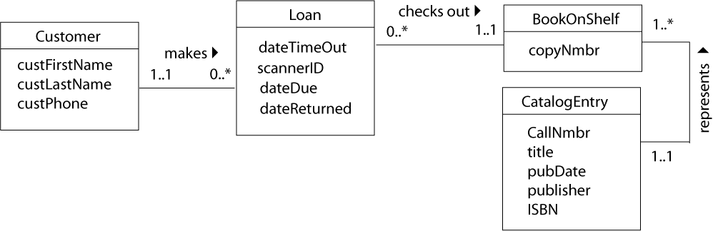
Design Pattern: Many-to-Many With History(Library Loan)–Class Diagram

Slide 80
Design Pattern: Many-to-Many With History (Library Loan)–Keys
As in the order entry example, the Customers table will need a surrogate key to save space when it is copied in the Loans.
The CatalogEntry already has two external surrogate keys: the call number and the ISBN.
The first of these is defined by the Library of Congress Classification system, and contains codes that represent the subject, author, and year published.
The second of these is defined by a standard, number 2108. We’ll use the callNmbr as the primary key, since it has more descriptive value than the ISBN and is smaller than the descriptive candidate key:
CK {title, pubDate}
The dateTimeOut is needed as part of the key in the Loans table in order to pair a customer with the same book more than once.

Slide 81
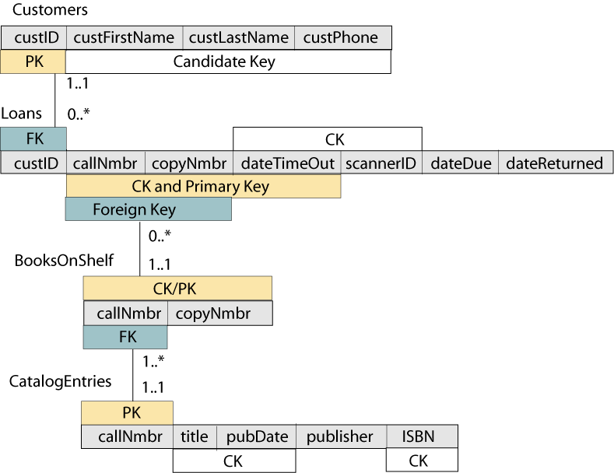
Design Pattern: Many-to-Many With History (Library Loan)–Diagram

Slide 82
Design Pattern: Many-to-Many With History (Library Loan)
As we would do in a junction table scheme, we’ll copy the primary key attributes from both the Customers and the BooksOnShelf into the Loans scheme. This tells us which customer borrowed which book, but it doesn't tell when it was borrowed. We have to know the dateTimeOut in order to pair a customer with the same book more than once.
We can call this a discriminator attribute, since it allows us to discriminate between the multiple pairings of customer and book. If you refer back to the UML class diagram, you’ll see that the loan, which would have been a many-to-many association class between customers and books, has become a “real” class because of the discriminator attribute.
Notice that there is actually another CK for the loan:
{dateTimeOut, scannerID}
since it is also physically impossible for the same scanner to read two different
books at exactly the same time.
We chose {callNmbr, copyNmbr, dateTimeOut} because it has just a bit more descriptive value and because we don’t care about size here (since the Loan has no children).

Slide 83
Colliding Foreign Keys
Occasionally a connection between two classes can occur along more than one relationship path.
When that happens, as a designer, you need to decide whether the instance of that common ancestor must be the same for two or more of those paths, or whether it should be different.
Unfortunately, UML, because it does not deal with migrating foreign keys, has no way to capture this design decision.
However, the relation scheme diagram will allow you to capture this aspect of your design.
Notes:
My first data modeling language, IDEF 1-x, was more physical than UML class modeling, and we would see the migrating foreign keys, and explicitly note when we role named them. Even in the relation scheme diagram, the role naming isn’t actually highlighted, you have to be paying attention to even notice it.

Slide 84
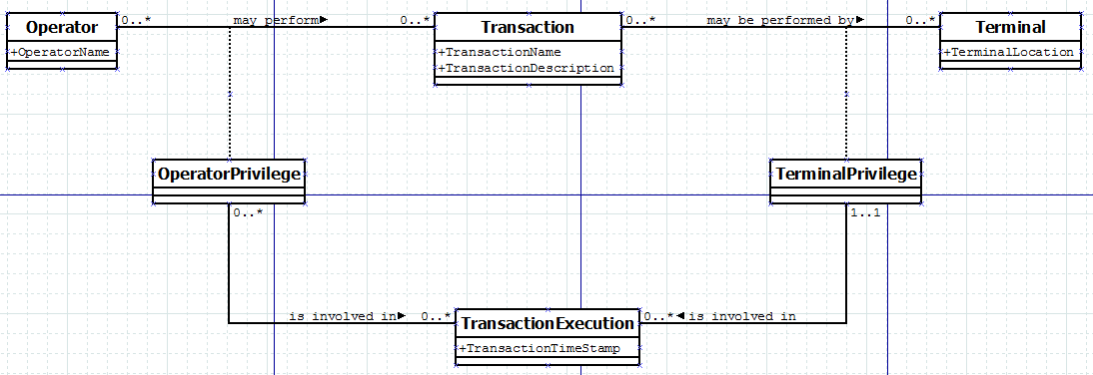
Colliding Foreign Keys Example
Back in the day, we used to authorize certain transactions to certain hard-wired terminals.
In addition, only certain operators could perform certain transactions.
A given transaction execution was then an intersection between the authorization of a terminal and an operator.
Thomas Bruce Designing Quality Databases with IDEF1X Information Models
Dorset House Publishing 1992

Slide 85
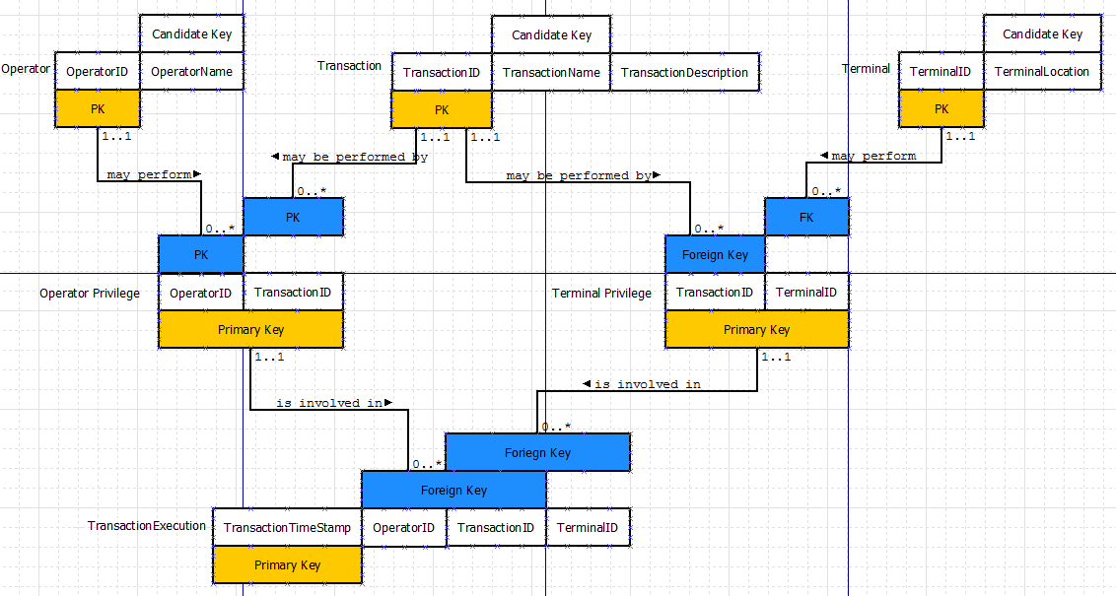
Colliding Foreign Keys in the Relation Scheme Diagram
The TransactionID migrates through OperatorPrivilege as well as TerminalPrivilege.
The assertion is that it has to be the same transaction from both sources in order for the transaction to be valid.
Note that you cannot capture that constraint without the relation scheme model.

Slide 86
And Finally, the DDL
create table operator (
OperatorID int not null generated always as identity
(start with 1, increment by 1) constraint operator_PK primary key,
OperatorName varchar(100) not null constraint operator_UK01 unique);
create table "transaction" (
TransactionID int not null generated always as identity
(start with 1, increment by 1),
TransactionName varchar(100) not null constraint transaction_UK01 unique,
TransactionDescription varchar(500),
constraint transaction_PK primary key(TransactionID));
create table terminal (
TerminalID int not null generated always as identity
(start with 1, increment by 1) primary key,
TerminalLocation varchar(100) not null constraint terminal_UK01 unique);

Slide 87
DDL Continued
create table operatorPrivilege (
OperatorID int not null constraint Operator_OperatorPrivilege
references Operator(OperatorID),
TransactionID int not null constraint Transaction_OperatorPrivilege
references "transaction"(TransactionID),
constraint operatorPrivilege_PK primary key (OperatorID, TransactionID)
);
create table terminalPrivilege (
TransactionID int not null constraint Transcation_TerminalPrivilege
references "transaction"(TransactionID),
TerminalID int not null constraint Terminal_TerminalPrivilege
references terminal(TerminalID),
constraint terminalPrivilege_PK primary key (TransactionID, TerminalID));

Slide 88
DDL Continued
create table transactionExecution(
transactionTimeStamp timestamp not null constraint
transactionExecution_PK primary key,
OperatorID int not null,
TransactionID int not null,
TerminalID int not null,
constraint operatorPrivilege_transaction_FK01 foreign key
(OperatorID, TransactionID)
references OperatorPrivilege
(OperatorID, TransactionID),
constraint terminalPrivilege_transaction_FK01 foreign key
(TransactionID, TerminalID)
references terminalPrivilege
(TransactionID, TerminalID));
Notice that TransactionID comes in to transactionExecution twice, once from OperatorPrivilege, and once from TerminalPrivilege.
Since we do not change the name of the attribute in the child table, the value of TransactionID coming from those two sources must agree.

Slide 89
Additional Points
We could have role named the TransactionID coming from each relationship and used the same name in both cases, and that would have achieved the same constraint.
In this case, there was a surrogate in the common ancestor, but you could have a case with multiple members of the key.
In such a case, you could role name just some of the common ancestor’s keys for clarity.

Slide 90
What Happens With Surrogates?
Surrogates encapsulate.
The relationship from the parent is to the child is non-identifying if the child has a surrogate.
You could still get the same constraint using a 3rd generation language trigger.
The database structure is more declarative, easier to understand.
One more thing to consider when deciding whether to go with surrogates or natural keyes.

Slide 91
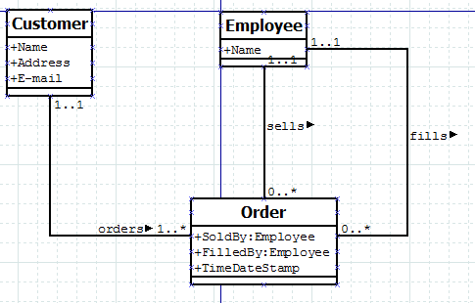
Role naming “out of the way”
The employee plays two separate roles for the order.
UML allows us to specify the type of our attributes, and in this case, it’s worthwhile to indicate that each of these roles is of the Employee type.

Slide 92
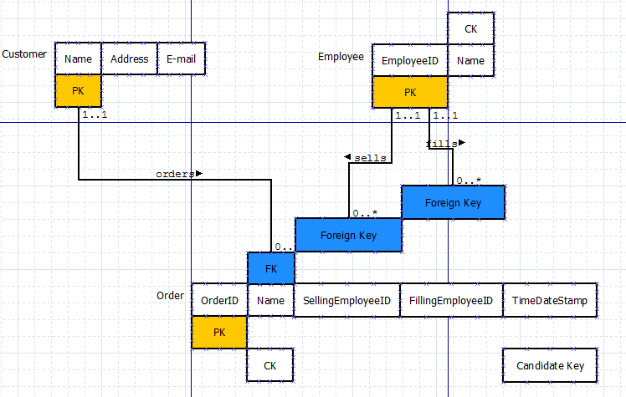
The Relation Scheme Diagram
There is a separate attribute in Order for each of the employees related to the order.
We only had to role name one of them, but I chose to role name both in order to be more explicit.

Slide 93
And Finally the DDL
create table customer (
name varchar(100) not null constraint customer_PK primary key,
Address varchar(100) not null,
E_mail varchar(100) not null);
create table employee (
EmployeeID int not null generated always as identity
(start with 1, increment by 1)
constraint employee_pk primary key,
Name varchar(100) constraint employee_UK01 unique);

Slide 94
DDL for the Order Table
create table "order" (
OrderID int not null generated always as identity
(start with 1, increment by 1)
constraint order_pk primary key,
name varchar(100) not null constraint customer_order_fk01
references customer(name),
sellingEmployeeID int not null constraint employee_order_fk01
references employee (employeeID),
fillingEmployeeID int not null constraint employee_order_fk02
references employee (employeeID),
TimeDateStamp timestamp not null,
constraint order_uk01 unique (name, timeDateStamp));
The employee ID comes in through two separate relationships: one sells the order, the other employee fills it (pulls stock, prepares for shipping, …)
Both of those employees could be the same person
But they don’t have to be.

Slide 95
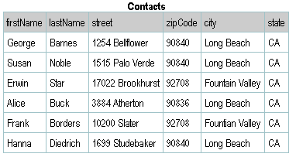
Design Pattern: Subkeys (the Zipcode) - Problem
It may not be obvious that the model has a problem until you look at the data

Slide 96
Design Pattern: Subkeys (the Zipcode) – Functional Dependency
functional dependency is simply a more formal term for the super key property. If X and Y are sets of attributes, then the notation X→Y is read “X functionally determines Y” or “Y is functionally dependent on X.” This means that if I’m given a table filled with data plus the value of the attributes in X, then I can uniquely determine the value of the attributes in Y.
A super key always functionally determines all of the other attributes in a relation (as well as itself). This is a “good” FD. A “bad” FD happens when we have an attribute or set of attributes that are a super key for some of the other attributes in the relation, but not a super key for the entire relation. We call this set of attributes a subkey of the relation.

Slide 97
Design Pattern: Subkeys (the Zipcode) – Functional Dependency (con’t).
A subkey dependency enables us to detect when a relation scheme has redundancy -- when a table using the scheme will contain unnecessary duplication of information.
A relation scheme has redundancy whenever there is a subkey dependency.

Slide 98
Design Pattern: Subkeys (the Zipcode) – Preventing/Removing Redundancy
There is a very simple way to fix the problem with a relation scheme that has redundancy, as detected by the presence of a subkey.
In the steps given below, the scheme with redundancy is R and the subkey is represented by the FD W→Z, where each of W and Z is a set of attributes that is a subset of the attributes in R.

Slide 99
Design Pattern: Subkeys (the Zipcode) – Preventing/Removing Redundancy(con’t).
Replace R by two schema, R₁ and R₂ as described in the following steps.
Assign R₁ the attributes in the union of the attributes in the subkey FD. That is R₁={W ∪ Z}. Since W→Z, by definition, W is a superkey of R₁.
Assign R₂ the set of attributes {R - Z}, that is, all the attributes in R except those in Z, the attributes on the right-hand-side of the subkey FD
Both R₁ and R₂ share W in common. In R₁, W is a superkey and in R₂ it becomes a foreign key.

Slide 100
Design Pattern: Subkeys (the Zipcode) – Preventing/Removing Redundancy(con’t).
The “bad” subkey dependency has been removed because we’ve moved the attributes that were functionally dependent on W to another scheme, and we’ve made W the super key of that scheme.

Slide 101
Design Pattern: Subkeys (the Zipcode) - Solution
In other words:
Remove all of the attributes that are dependent on the subkey. Put them into a new scheme.
Duplicate the subkey attribute set in the new scheme, where it becomes the primary key of the new scheme.
Leave a copy of the subkey attribute set in the original scheme, where it is now a foreign key. It is no longer a subkey, because you’ve gotten rid of the attributes that were functionally dependent on it, and you’ve made it the primary key of its own table. The revised model will have a many-to-one relationship between the original scheme and the new one.

Slide 102
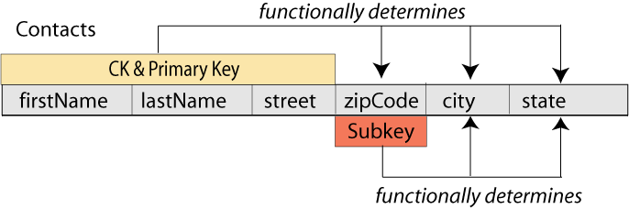
Design Pattern: Subkeys (the Zipcode) - Subkey
In the Contacts table, the zipCode is a subkey. It functionally determines the city and state. The opposite is not true, because many cities have more than one zip code.

Slide 103
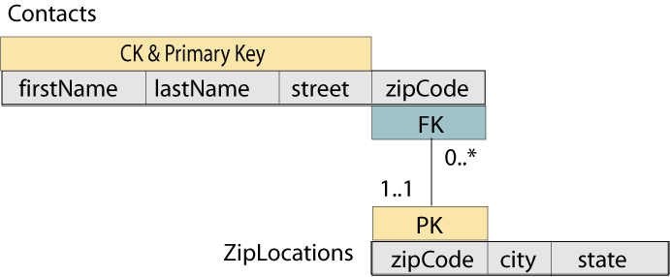
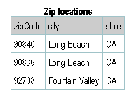
Design Pattern: Subkeys (the Zipcode) – Lossless Join Decomposition
Moving the data to a new table and then joining the two tables is called lossless join decomposition of the original table

Slide 104
Design Pattern: Subkeys (the Zipcode) - Normalization
Normalization means following a procedure or set of rules to insure that a database is well designed. Most normalization rules are meant to eliminate redundant data (that is, unnecessary duplicate data) in the database.
Subkeys always result in redundant data, so we need to eliminate them. If there are no subkeys in any of the tables in your database, you have a well-designed model according to what is usually called third normal form, or 3NF.
Edgar F. Codd was a mathematician and computer scientist who laid the theoretical foundation for relational databases.
“The key, the whole key and nothing but the key so help me Codd”

Slide 105
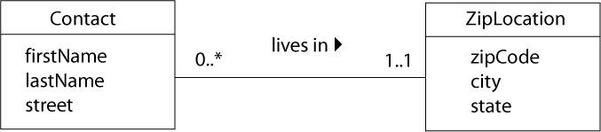
Design Pattern: Subkeys (the Zipcode) – Class Diagram
When we find a subkey in a relation scheme or table, we also know that the original UML class was badly designed. The problem, always, is that we have actually placed two conceptually different classes in a single class definition.
In this example, a zipCode is not just an attribute of the Contact class. It is part of a ZipLocation class, which we can describe as “a geographical location whose boundaries have been uniquely identified by the U.S Postal Service for mail delivery.”
As with all one-to-many associations, the association itself identifies which Contact lives in which ZipLocation. If we had started with this class diagram, we would have produced exactly the same relation scheme that we developed with the normalization process above!

Slide 106
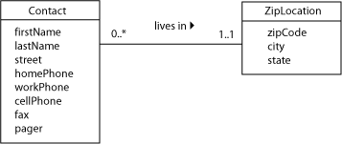
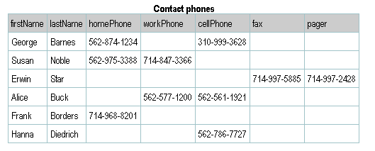
Design Pattern: Repeated Attributes (the Phone Book)
The contact manager example from our preceding discussion of subkeys is also an excellent illustration of another problem that is found in many database designs.

Slide 107
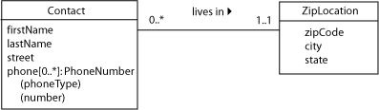
Design Pattern: Repeated Attributes (the Phone Book) – Weak Entity
Note the large amount of null values and the inability of the model to keep up with changing times. Notice that the phone numbers are actually repeated attributes. It is essentially a class within a class.
This can be called a weak entity since it can’t exist without the parent entity type.

Slide 108
Design Pattern: Repeated Attributes (the Phone Book) - Fix
In order to fix this problem we need to create a new table:
Remove all of the phone number fields from the Contacts relation. Create a new scheme that has the attributes of the phone number structure (phone type and number).
The Contacts relation has now become a parent so we add a surrogate key and copy it into the new scheme. There is now a one-to-many relationship between Contacts and PhoneNumbers.
To identify each phone number, we need to know at least who it belongs to and what type it is. However, a person can have two cell phones so all three attributes are needed for the PK. Since this is not a parent relation, the PK size doesn’t matter.

Slide 109
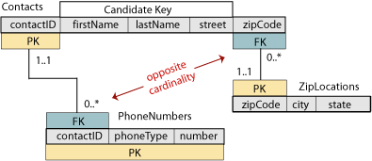
Design Pattern: Repeated Attributes (the Phone Book) - Relation Scheme

Slide 110
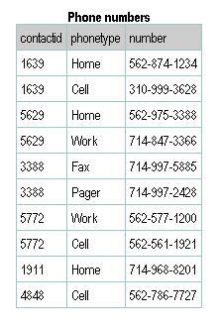
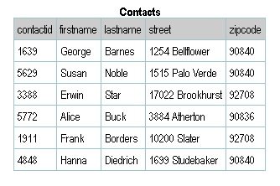
Design Pattern: Repeated Attributes (the Phone Book) – Tables

Slide 111
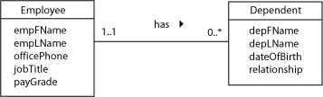
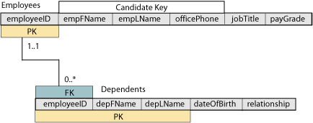
Design Pattern: Repeated Attributes (the Phone Book) - Employees
The modeling technique shown above is useful where the parent class has relatively few attributes and the repeated attribute has only one or a very few attributes of its own. However, you can also model the repeated attribute as a separate class in the UML diagram. One classic textbook example is an employee database.

Slide 112
Design Pattern: Repeated Attributes (the Phone Book) – Employees (cont)
This is the same example using the “shorthand” notation.

Slide 113
Recognizing Repeating Attributes
Sometimes the name gives it away, as in the above case.
Sometimes the values themselves suggest that there is a repeating attribute afoot.
If in doubt, ask for sample data.
And/or ask whether there is any specific format for a set of field values.

Slide 114
Let’s put some business rules in
A given faculty member (person, really) can only earn one degree of a given type in a given subject. For instance, you can only get a Physics BS once. Believe me, that’s enough.
Then let’s also say that only certain universities offer a given degree type (BS, MS, PhD, …) in certain subjects.
What would that look like in the UML?

Slide 115
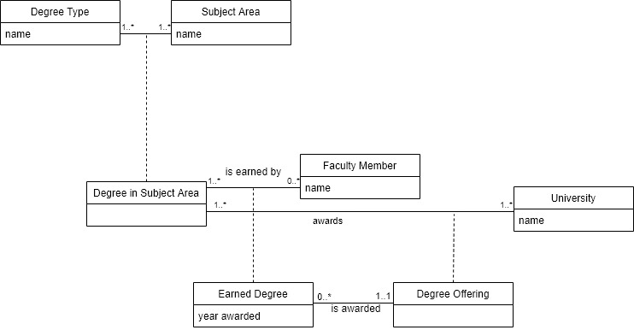
UML

Slide 116
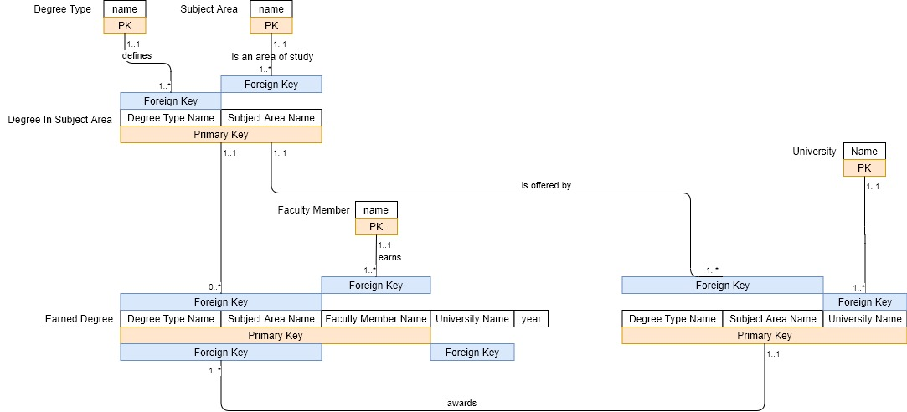
Relation Scheme

Slide 117
Design Pattern: Multi-Valued Attributes (Hobbies)
When there are many distinct values entered in the same column of the table we have another design problem called multi-valued attributes .
This makes it difficult to search the table for any one particular value and it is impossible to create a query that will individual list the values in that column. For example: hobbies.

Slide 118
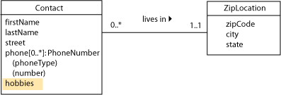
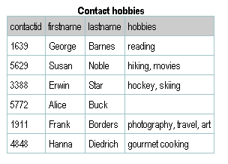
Design Pattern: Multi-Valued Attributes (Hobbies) – Class Diagram

Slide 119
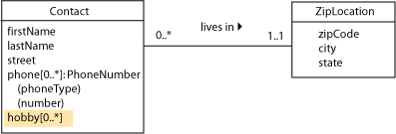
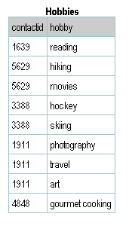
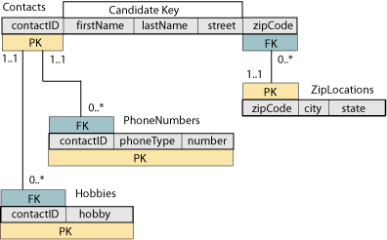
Design Pattern: Multi-Valued Attributes (Hobbies) - Corrected

Slide 120
Signs that you have a multi-valued attribute
The value in the legacy system is variable length and can be very long.
The attribute name is plural.
The values have some sort of delimiter in them like , | or something else to mark the end of one value and the start of the next.
Be sure to pay attention to the order. Something like author order might be implicit in the data and will need to be made explicit in the design.

Slide 121
Discussion: More About Domains
Remember that a domain is the set of legal values that can be assigned to an attribute. Each attribute in a database must have a well-defined domain.
One goal of database developers is provide data integrity, part of which means insuring that the value entered in each field of a table is consistent with its attribute domain.
Sometimes it’s possible to devise a validation rule to help with this. Before you can design the data type and input format for an attribute, you have to understand the characteristic of its domain.

Slide 122
Discussion: More About Domains - Validation
Some domains can only be described with a general statement of what they contain. Examples: name, addresses. For this, use a VARCHAR2 string that is long enough to hold the expected value.
Some domains have at least some pattern. Examples, email addresses, URLs, North American phone numbers. These must be validated programmatically such as with a regular expression.
Some domains have precise patterns. For example, SSNs and zip code.

Slide 123
Discussion: More About Domains – More Validations
Easy domains to handle are those which can be specified by a well-defined, built-in system data type. These include integers, real numbers, and dates/times.
You might need a range check.
In most systems, a Boolean data type is also available although Oracle does not.
Finally, there are many domains that may be specified by a well-defined, reasonably-sized set of constant values. These are enumerated domains and we’ll cover these in the next section. For example, departments in the school, states.

Slide 124
Design Pattern: Enumerated Domains
Attribute domains that may be specified by a well-defined, reasonable-size set of constant values are called enumerated domains. These values should be kept in a separate table. Tables that are created for this purpose are commonly called lookup tables.
Although it might appear that this technique will create too many tables and query joins, the advantages outweigh the disadvantages. You can always break the rule if you have to for performance reasons.

Slide 125
Design Pattern: Enumerated Domains - Advantages
Data Integrity – changing the data in one place, avoiding deletion anomalies
You can read the values form the table into a combo box, list box or similar input control on either a web page or a GUI form. This allows the user to easily select only values that are valid in this domain at this time.
You can always update the table if new values are added to the domain, or if existing values are changed. This is much easier than modifying your user-interface code or your table structure.

Slide 126
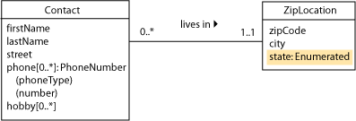
Design Pattern: Enumerated Domains – Class Diagram
In our earlier ZipLocations example, the state attribute clearly fits the definition of an enumerated domain. In UML, we can simply use a data type specification to show this, without adding a new class type.

Slide 127
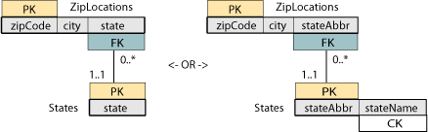
Design Pattern: Enumerated Domains – Relation Scheme
The relation scheme will show the table that contains the enumerated domain values. This table might have a single attribute, or it might have two attributes: one for the true values and one for a substitute key. The true values always form a candidate key of the table.

Slide 128
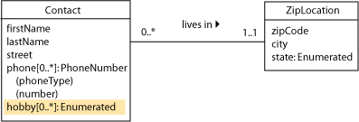
Design Pattern: Enumerated Domains – Multi-Valued Attributes
Multi-valued attributes might also have enumerated domains.

Slide 129
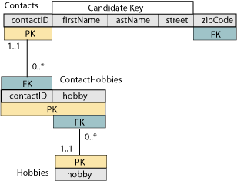
Design Pattern: Enumerated Domains – Many-to-Many Relation Scheme
In the scheme, the relationship between Contacts and Hobbies has become many-to-many, instead of one-to-many. This is shown in the scheme by linking an enumeration table to the previous Hobbies tables (which now functions like an association class).

Slide 130
Design Pattern: Subclasses –Top Down Design
As you are developing a class diagram, you might discover that one or more attributes of a class are characteristics of only some individuals of that class, but not of others. This probably indicates that you need to develop a subclass of the basic class type. We call the process of designing subclasses from “top down” specialization. A class that represents a subset of another class type can also be called a specialization of its parent class.
Example: we will model the graduate students at a university. Some are employed by the university as teaching associates (TAs). Some are employed as research associates (RAs). Some are not employed by the university at all. For the TAs, we need to know which course they are assigned to teach. For the RAs, we need to know the grant number of the research project to which they are assigned.

Slide 131


Design Pattern: Subclasses –Top Down Design – Class Diagrams
Note that one of the attributes courseAssignment or researchGrant will always be null
Common attributes are in the parent class, unique attributes are in the subclass

Slide 132
Design Pattern: Subclasses –Top Down Design–Specialization Constraints
Rather than with the usual cardinality symbols, the subclass association line is label with specialization constraints. Constraints are described along two dimensions: incomplete vs. complete, and disjoint vs. overlapping.
incomplete or partial specialization, only some individuals of the parent class are specialized.
complete specialization, all individuals of the parent class have one or more unique attributes that are not common to the generalized (parent) class.
disjoint or exclusive specialization, an individual of the parent class may be a member of only one specialized subclass.
overlapping specialization, an individual of the parent class may be a member of more than one specialized subclass.

Slide 133

Design Pattern: Subclasses –Top Down Design – Relation Scheme
Note that the PK of the parent is the PK/FK of the child as this is a one-to-one relationship.

Slide 134
Design Pattern: Subclasses - Bottom Up Design
Sometimes, instead of finding unique attributes in a single class type, you might find two or more classes that have many of the same attributes. This probably indicates that you need to develop a superclass of the classes with common attributes.
We call the process of designing subclasses from “bottom up” generalization. A class or entity that represents a superset of other class types can also be called a generalization of the child types.
Example: Consider a brush-clearing service. This is a fairly specialized business, where dried plant growth (brush) can present a severe fire hazard if it is not cleared from around houses and other structures.

Slide 135

Design Pattern: Subclasses – Bottom Up Design – Class Diagram
One important class type was the lot (or property) to be cleared. Some lots were in the city, with a standard street-and-number address.
Other lots were not on a city street, but were described by the county surveyor's section and tract number.
It seemed as if there were two class types:

Slide 136


Design Pattern: Subclasses – Bottom Up Design – Relation Scheme
Actually, a few of the lots were identified by both address schemes. A closer look at the city and county lot classes also shows two common descriptive attributes (the owner and the lot size). The common attributes should go in a generalization or superclass that is simply called a “lot.”

Slide 137
What about a categorization with only one category?
Occasionally it becomes necessary to model a categorization in which only one category is at all significant.
An example would be employees in a firm in which the executives receive incentive compensation in the form of a % of the overall profits.
The rest of the employees don’t have that attribute, so you can argue that the executives form a specialization of employees.
In such a case, the categorization constraints should always be {incomplete, disjoint}
If it were complete, there would be no need to separate the category out from the generic parent.
If there were other categories, it would be possible for the categorization to be overlapping. But since there are not, we’ll call it disjoint.

Slide 138
Does each category have to have distinct attributes?
In a word, “no”.
It’s common to feel uncomfortable with categorizations that have one or more categories with no peculiar attributes.
The mere existence of the category is significant.
Also, any associations that are only proper to that category are significant.

Slide 139

A More Complex Example

Slide 140
Comments on the Above
Note that Guest and Citizen do not have any attributes that are peculiar to them, but Guest has a unique association: sponsors.
An employee could also be a student at some time.
A member of administration (I know one of these) can also teach here.
On the other hand, you are either a Professor or an Instructor, you cannot be both. Which is not to say that an instructor could not have a PhD.
From a layout perspective, please try to have your categorizations point upward if possible.
Person participates in two independent categorizations: Guest/Citizen and Student/Employee at the same time. Those two categorizations are independent of each other. Which category the Person falls into in one categorization says nothing about which category the fall into in the other.
Notes:
The intent here is not overwhelm, but to remind the students that there are lots of options with categorization: categories can be further categorized, you do not have to have attributes that are peculiar to a category for that category to be legitimate,

Slide 141
Design Pattern: Aggregation
An aggregation is when a class type really represents a collection of individual components. Although this pattern can be modeled by an ordinary association, its meaning becomes much clearer if we use the UML notation for an aggregation.
Example: a small business needs to keep track of its computer systems. They want to record information such as model and serial number for each system and its components.

Slide 142

Design Pattern: Aggregation – Incorrect Model vs. Improved Model
Note that the incorrect model uses repeated attributes for the components. This is fixed in the improved model although there are still some problems – what if there are components on the shelf that don’t belong to a system

Slide 143

Design Pattern: Aggregation – Model with UML Aggregation
The system is an aggregation of components.
There is an implied multiplicity on the diamond end of 0..1 with multiplicity of the other end shown in the diagram.

Slide 144

Design Pattern: Aggregation – Relation Scheme
Since the component can exist by itself in this model the system name can’t be part of its PK.
We use the only candidate key {type,mgr,model,SN} as the PK since this class is not a parent. The system name, will be filled in if the component is installed as part of a system, otherwise it will be null.

Slide 145
Design Pattern: Aggregation – Composition
A composition is a stronger form of aggregation. The notation is similar using a filled-in diamond instead of an open one. In a composition, a component instance cannot exist on its own without a parent.
The implied multiplicity on the diamond end is 1..1.

Slide 146

Design Pattern: Aggregation – Composition Examples

Slide 147

Design Pattern: Aggregation – Composition Examples

Slide 148
Comments on these examples
The first model on the previous foil shows one room composed of several other rooms. Think of a conference center in which a room can be broken up into smaller rooms by deploying solid curtains as dividers.
That’s an example of a recursive relationship which we’ll be covering in more detail later. Basically it’s just another flavor of one to many.
The second example is a typical many to many with history, so you may wonder why the aggregation symbol is called for now. It’s because the relationship is required and identifying.
For my part, one enduring weakness that I see with UML is that it leaves unspecified whether or not a relationship is identifying. By using aggregation (non identifying) or composition (identifying) you can resolve that ambiguity.

Slide 149
Aggregation vs. Composition
There is no existential dependency implied by an aggregation, there is in a composition. Or, when the parent dies, it takes all of the children with it in composition.
The relationship in the relation scheme is non identifying for an aggregation and identifying for a composition.
From the software perspective, aggregation can be likened to collection by pointers (reference) where composition is collection by value.
The exact rules for when to use an aggregation versus a composition are open for debate, so be wary when you read other’s UML models.
Above all, avoid compositions in E flat – too many black keys.

Slide 150
Some examples
You run a engine rebuilding shop, and you have folks bring in their cars and boats to get the engine serviced. Would you model the relationship between engine and boat/car as an aggregation or a composition?
You are managing a set of stadiums. Each stadium has many seats, some of which are the cheap seats, while others are veritable salons. Would you use aggregation or composition to model the relationship from stadium to seat?
A species name is only unique within its genus.
You are managing a chess tournament. Each board has players on it during the scheduled match times. Each board has 64 squares on it. At any point in time, you are recording which players are on a board and where all of the pieces are, square by square. What is the relationship between board and player vs board and square?

Slide 151
Design Pattern: Aggregation – Definitions
Aggregation – (“has a” relationship)
In an aggregation relationship, the part may be independent of the whole but the whole requires the part.
Composition – (“uses a” relationship)
A composition relationship, also know as a composite aggregation, is a stronger form of aggregation where the part is created and destroyed with the whole.

Slide 152
Comparison Chart
Basis for comparison | Aggregation | Composition
Basic | In aggregation there exhibit a relationship where a child can exist independently of the parent. | In composition the cannot exist independently of the parent.
Type of relationship | "has a" | "part of"
Association type | Weak association | Strong association
UML design symbol | Represented by a hollow diamond next to assembly class. | Represented by a solid diamond next to assembly class.
Function | The deletion of assembly doesn't affect its parts. | If the owning class object is deleted, it could significantly affect the containing class object.

Slide 153
Aggregation – A Summary
Relationship Type | Symbol | Identifying | Required | Existential Dependency?
Aggregation |  | No | No | No
Composition |  | Yes | Yes | Yes
Non Descript |  | No | Yes | Yes
m..n
Identifying – the primary key of the parent becomes part of the primary key of the child.
Required – The multiplicity at the parent end is 1..1. Optional → multiplicity of 0..1.
Existential Dependency – the child cannot exist apart from the parent.

Slide 154
Design Pattern: Recursive Associations
A recursive association connects a single class type (serving in one role) to itself (serving in another role).
Example: employees and their managers

Slide 155

Design Pattern: Recursive Associations – Incorrect Relationship
The problem with this model is that each manager is also an employee so the manager table duplicates information in the employee table.

Slide 156

Design Pattern: Recursive Associations – Correct Relationship
Normally, we wouldn’t show an FK in the class diagram; however, including the manager as an attribute of the employee here (in addition to the association line) can help in understanding the model.

Slide 157

Design Pattern: Recursive Associations – Relation Scheme
In the relation scheme, we can explicitly show the connection between the surrogate PK (employeeID) and the managerID (which is an FK, even though it is in the same scheme).

Slide 158

Design Pattern: Recursive Associations – Many-to-Many Class Diagram
In some project-oriented companies, an employee might work for more than one manager at a time.
We also might want to keep a history of the employees’ supervision assignments over time. We can model either case by revising the class diagram to a many-to-many pattern.

Slide 159

Design Pattern: Recursive Associations – Many-to-Many Relation Scheme
The relation scheme for this model looks exactly like other many-to-many applications, with the exception that both foreign keys come from the same PK table.

Slide 160

Design Pattern: Recursive Associations – Retrieving Data
SELECT E.lastName AS "Employee", M.lastName AS "Manager"
FROM Employees E LEFT OUTER JOIN Employees M
ON E.managerID = M.employeeID
ORDER BY E.lastName

Slide 161
Design Pattern: Recursive Associations – Retrieving Data Many-to-Many
SELECT E.lastName AS "Employee", M.lastName AS "Manager"
FROM Employees E LEFT OUTER JOIN (Supervisions S INNER JOIN Employees M ON S.managerID = M.employeeID)
ON E.employeeID = S.employeeID
ORDER BY E.lastName

Slide 162
SQL for recursive relationships
You want to find the orders that have products in common with each other.
So you do a self join on orderDetails to get the orders that have a common product.
Then, count the number of common products between a given pair of orders.
Then, join, based on those order numbers, to the orders and customers to find the information about those orders.

Slide 163
Recursive relationship and subqueries
select one.orderNumber, one.productCode, two.ORDERNUMBER
from orderDetails one inner join orderDetails two using (productCode)
where one.ORDERNUMBER < two.ORDERNUMBER
order by one.ORDERNUMBER, two.ORDERNUMBER;
Here again, we use aliases to separate one use of the orderDetails table from the other.
There is no real distinction between them, so I’m just going with one and two so that I can distinguish them from each other.
Note the < to make sure I only get each pair once.

Slide 164
But that’s not very useful
select firstOrderNum, secondOrderNum, count(*) as countCommonProducts
from (select one.orderNumber as firstOrderNum,
one.productCode, two.ORDERNUMBER as secondOrderNum
from orderDetails one inner join
orderDetails two using (productCode)
where one.ORDERNUMBER < two.ORDERNUMBER) commonOrders
group by firstOrderNum, secondOrderNum;
Now, we count the number of common product items shared between two orders by grouping by the two order numbers.
That count gets called “countCommonProducts”.

Slide 165
Now for the coup de grace
select c1.customerName, o1.ORDERNUMBER, o1.orderDate, c2.customerName, o2.ORDERNUMBER, o2.orderDate, countCommonProducts
from (select firstOrderNum, secondOrderNum, count(*) as countCommonProducts
from (select one.orderNumber as firstOrderNum,
one.productCode, two.ORDERNUMBER as secondOrderNum
from orderDetails one inner join orderDetails two using (productCode)
where one.ORDERNUMBER < two.ORDERNUMBER) commonOrders
group by firstOrderNum, secondOrderNum) countedCommonOrders
inner join orders o1 on (firstOrderNum = o1.ORDERNUMBER)
inner join customers c1 on
(o1.CUSTOMERNUMBER = c1.CUSTOMERNUMBER)
inner join orders o2 on (secondOrderNum = o2.ORDERNUMBER)
inner join customers c2 on (o2.CUSTOMERNUMBER = o2.CUSTOMERNUMBER)
where c1.CUSTOMERNAME = 'Mini Caravy' and
c2.CUSTOMERNAME = 'Baane Mini Imports';

Slide 166
o1, o2, c1, c2?
We are joining from that collection of orders with common products along two different paths.
We need to distinguish which order number gets joined to orders and thence to customers so that we keep them straight.
The names, as you would guess, are immaterial. I chose these for brevity.

Slide 167

Relational Algebra Review
Remember that any expression that yields a relation in relational algebra can be renamed, given an alias: $ρ_{X}(R)$ where R is again the original relation, and X is the new name that you wish to give the relation.
Much like an alias for a subquery in SQL, you can use the new name elsewhere in the statement to refer to individual columns of that query.

Slide 168

RA Aliasing Continued
Aliasing columns in SQL is more than just cosmetic.
To give attributes in a relation new names: $ρ_{\frac{a,b}{y,z}}(R)$ where R is the original relation (either a table or an expression), a, b, … are the new name(s), and y, z, … are the old names.
To remember: $ρ$ is the Greek letter rho, which we use to rename something in Relational Algebra.
Notes:
The column headings should be descriptive. But there’s more. If you use the as operator to change the name of an expression or column, and the resulting relation is used as a subquery, then that alias name becomes the only way to access that value from the “outside”.

Slide 169

RA Recursive Query Example
Return the employee last name, first name, their manager’s last name and first name:
select e.lastName, e.firstName, m.lastName, m.firstName
from employees e inner join employees m
on e.reportsTo = m.employeeNumber
order by e.lastName, m.lastname;
That equates to this in Relational Algebra:
$π_{E.LASTNAME, E.FIRSTNAME, M.LASTNAME, M.FIRSTNAME}$
$${ρ }_{E}EMPLOYEES⋈_{E.REPORTSTO=M.EMPLOYEENUMBER} {ρ }_{m}EMPLOYEES$$
We had to assign a role name/alias name to Employees to do the recursive join, as well as refer to the manager’s first & last name.

Slide 170

Role naming the attributes
The relational algebra query:
$π_{E.LASTNAME, E.FIRSTNAME, M.LASTNAME, M.FIRSTNAME}$
$${ρ }_{E}EMPLOYEES⋈_{E.REPORTSTO=M.EMPLOYEENUMBER} \\ {ρ }_{m}EMPLOYEES$$
Doesn’t give us distinctive column headers for the manager names.
$π_{E.LASTNAME, E.FIRSTNAME, M.LASTNAME, M.FIRSTNAME}$
$${ρ_{\frac{firstname, lastname}{employee first name, employee last name}}ρ }_{E}EMPLOYEES \\ ⋈_{E.REPORTSTO=M.EMPLOYEENUMBER} \\ ρ_{\frac{firstname, lastname}{manager first name, manager last name}}{ρ }_{m}EMPLOYEES$$

Slide 171
This is more than cosmetics
When we use an expression as a sub query, the column names output by the sub query are exactly what we need to reference in the outer query.
If we had the above query as a subquery, without the role names it would look as though it had two first names and two last names.
Technically, that’s a syntax error in Relational Algebra since the relation scheme is a set of attributes, and there can be no duplicates in a set.

Slide 172
Appendix: Traditional Normalization
Normalization is usually thought of as a process of applying a set of rules to your database design, mostly to achieve minimum redundancy in the data. Most textbooks present this as a three-step process, with correspondingly label “normal forms.
In theory, you could start with a single relation scheme (sometimes called the universal scheme, or U) that contains all of the attributes in the database—then apply these rules recursively to develop a set of increasingly-normalized sub-relation schemes. When all of the schemes are in third normal form, then the whole database is properly normalized.
In practice, you will more likely apply the rules gradually, refining each relation scheme as you develop it from the UML class diagram or ER model diagram. The final table structures should be the same no matter which method (or combination of methods) you’ve used.

Slide 173
Normalization Methods
Analysis
Decomposition method shown previously
Synthesis
Begin with attributes, combine them into groups having the same determinant
Use functional dependencies to develop a set of normalized relations
Mapping from ER diagram provides almost-normalized schema

Slide 174
Objectives of Normalization
Develop a good description of the data, its relationships and constraints
Produce a stable set of relations that
Is a faithful model of the enterprise
Is highly flexible
Reduces redundancy-saves storage space and reduces inconsistency in data
Is free of update, insertion and deletion anomalies

Slide 175
Characteristics of Normalized Schemas
Each relation has a “theme”, relaying facts about a single subject
The subject can be either an entity or a relationship
Each cell of the table contains a single fact about that subject

Slide 176
Normal Forms
First normal form -1NF
Second normal form-2NF
Third normal form-3NF
Boyce-Codd normal form-BCNF
Higher normal forms
Each is contained within the previous form – each has stricter rules than the previous form

Slide 177
Types of Dependencies
Functional dependencies
Multi-valued dependencies
Join dependencies
Others
All can cause problems in relational design

Slide 178

Appendix: Traditional Normalization – Normal Forms

Slide 179
Functional Dependency-FD
A functional dependency (FD) is a type of relationship between attributes
If A and B are sets of attributes of relation R, we say B is functionally dependent on A if each A value in R has associated with it exactly one value of B in R.
Alternatively, if two tuples have the same A values, they must also have the same B values
Write A→B, read A functionally determines B, or B functionally dependent on A
FD is actually a many-to-one relationship between A and B

Slide 180
Example of FDs
Stuid | lastName | major | credits | status | socSecNo
S1001 | Smith | History | 90 | Senior | 100429500
S1003 | Jones | Math | 95 | Senior | 010124567
S1006 | Lee | CSC | 15 | Freshman | 088520876
S1010 | Burns | Art | 63 | Junior | 099320985
S1060 | Jones | CSC | 25 | Freshman | 064624738
Let R be
NewStudent(stuId, lastName, major, credits, status, socSecNo)
FDs in R include
{stuId}→{lastName}, but not the reverse
{stuId} →{lastName, major, credits, status, socSecNo, stuId}
{socSecNo} →{stuId, lastName, major, credits, status, socSecNo}
{credits}→{status}, but not {status}→{credits}

Slide 181
Trivial Functional Dependency
The FD X→Y is trivial if set {Y} is a subset of set {X}
Examples: If A and B are attributes of R,
{A}→{A}
{A,B} →{A}
{A,B} →{B}
{A,B} →{A,B}
are all trivial FDs

Slide 182
First Normal Form-1NF
A relation is in 1NF if and only if every attribute is single-valued for each tuple
Each cell of the table has only one value in it
Domains of attributes are atomic: no sets, lists, repeating fields or groups allowed in domains

Slide 183
Counter-Example for 1NF
Stuid | lastName | major | credits | status | socSecNo
S1001 | Smith | History | 90 | Senior | 100429500
S1003 | Jones | Math | 95 | Senior | 010124567
S1006 | Lee | Math | 15 | Freshman | 088520876
 |  | CSC
S1010 | Burns | English | 63 | Junior | 099320985
 |  | Art
S1060 | Jones | CSC | 25 | Freshman | 064624738
NewStu(StuId, lastName, major, credits, status, socSecNo) – Assume students can have more than one major
The major attribute is not single-valued for each tuple

Slide 184
Ensuring 1NF
Best solution: For each multi-valued attribute, create a new table, in which you place the key of the original table and the multi-valued attribute. Keep the original table, with its key
Ex. NewStu2(stuId, lastName, credits,status, socSecNo)
Majors(stuId, major)
NewStu2
Majors
stuId | major
S1001 | History
S1003 | Math
S1006 | CSC
S1006 | Math
S1010 | Art
S1010 | English
S1060 | CSC
Stuid | lastName | credits | status | socSecNo
S1001 | Smith | 90 | Senior | 100429500
S1003 | Jones | 95 | Senior | 010124567
S1006 | Lee | 15 | Freshman | 088520876
S1010 | Burns | 63 | Junior | 099320985
S1060 | Jones | 25 | Freshman | 064624738

Slide 185
Full Functional Dependency
In relation R, set of attributes B is fully functionally dependent on set of attributes A of R if B is functionally dependent on A but not functionally dependent on any proper subset of A
This means every attribute in A is needed to functionally determine B
Must have multivalued key for relation to have FD problem

Slide 186
Partial Functional Dependency Example
NewClass( courseNo, stuId, stuLastName, facId, schedule, room, grade)
FDs:
{courseNo,stuId} → {lastName}
{courseNo,stuId} →{facId}
{courseNo,stuId} →{schedule}
{courseNo,stuId} →{room}
{courseNo,stuId} →{grade}
courseNo → facId **partial FD
courseNo → schedule **partial FD
courseNo →room ** partial FD
stuId → lastName ** partial FD
…plus trivial FDs that are partial…

Slide 187
Second Normal Form-2NF
A relation is in second normal form (2NF) if it is in first normal form and all the non-key attributes are fully functionally dependent on the key.
No non-key attribute is FD on just part of the key
If key has only one attribute, and R is 1NF, R is automatically 2NF

Slide 188
Converting to 2NF
Identify each partial FD
Remove the attributes that depend on each of the determinants so identified
Place these determinants in separate relations along with their dependent attributes
In original relation keep the composite key and any attributes that are fully functionally dependent on all of it
Even if the composite key has no dependent attributes, keep that relation to connect logically the others

Slide 189
2NF Example
NewClass(courseNo, stuId, stuLastName, facId, schedule, room, grade )
FDs grouped by determinant:
{courseNo} → {courseNo,facId, schedule, room}
{stuId} → {stuId, lastName}
{courseNo,stuId} → {courseNo, stuId, facId, schedule, room, lastName, grade}
Create tables grouped by determinants:
Class2(courseNo,facId, schedule, room)
Stu(stuId, lastName)
Keep relation with original composite key, with attributes FD on it, if any
Register( courseNo, stuId, grade)

Slide 190
2NF Example
courseNo | stuId | stuLastName | facId | schedule | room | grade
ART103A | S1001 | Smith | F101 | MWF9 | H221 | A
ART103A | S1010 | Burns | F101 | MWF9 | H221
ART103A | S1006 | Lee | F101 | MWF9 | H221 | B
CSC201A | S1003 | Jones | F105 | TUTHF10 | M110 | A
CSC201A | S1006 | Lee | F105 | TUTHF10 | M110 | C
HST205A | S1001 | Smith | F202 | MWF11 | H221
First Normal Form Relation
Register
Stu
Class2
courseNo | stuId | grade
ART103A | S1001 | A
ART103A | S1010
ART103A | S1006 | B
CSC201A | S1003 | A
CSC201A | S1006 | C
HST205A | S1001
stuId | stuLastName
S1001 | Smith
S1010 | Burns
S1006 | Lee
S1003 | Jones
courseNo | facId | schedule | room
ART103A | F101 | MWF9 | H221
CSC201A | F105 | TUTHF10 | M110
HST205A | F202 | MWF11 | H221
Second Normal Form Relations

Slide 191
Transitive Dependency
If A, B, and C are attributes of relation R, such that A → B, and B → C, then C is transitively dependent on A
Example:
NewStudent (stuId, lastName, major, credits, status)
FD:
credits→status (and several others)
By transitivity:
stuId→credits ∧ credits→status implies stuId→status
Transitive dependencies cause update, insertion, deletion anomalies.

Slide 192
Third Normal Form-3NF
A relation is in third normal form (3NF) if whenever a non-trivial functional dependency X→A exists, then either X is a superkey or A is a member of some candidate key
To be 3NF, relation must be 2NF and have no transitive dependencies
No non-key attribute determines another non-key attribute. Here key includes “candidate key”

Slide 193
Example Transitive Dependency
NewStudent
Stuid | lastName | Major | Credits | Status
S1001 | Smith | History | 90 | Senior
S1003 | Jones | Math | 95 | Senior
S1006 | Lee | CSC | 15 | Freshman
S1010 | Burns | Art | 63 | Junior
S1060 | Jones | CSC | 25 | Freshman
Transitive Dependency: Stuid → Credits and Credits → Status
NewStu2
Stats
Stuid | lastName | Major | Credits
S1001 | Smith | History | 90
S1003 | Jones | Math | 95
S1006 | Lee | CSC | 15
S1010 | Burns | Art | 63
S1060 | Jones | CSC | 25
Credits | Status
15 | Freshman
25 | Freshman
63 | Junior
90 | Senior
95 | Senior
Removed Transitive Dependency

Slide 194
Making a relation 3NF
For example,
NewStudent (stuId, lastName, major, credits, status)
with FD credits→status
Remove the dependent attribute, status, from the relation
Create a new table with the dependent attribute and its determinant, credits
Keep the determinant in the original table
NewStu2 (stuId, lastName, major, credits)
Stats (credits, status)

Slide 195
Appendix: Traditional Normalization – Denormalization
You database will always be part of a larger system, which will include at least a user interface and reporting structure or the back-end of a Web site, with both middle-tier business logic and front-end presentation code dependent on it.
It is not uncommon for developers to “break the rules” of database design in order to accommodate other parts of a system. This is called denormalization.

Slide 196
Denormalization Life Cycle
Always take the time and effort to fully design the database in normalized form. Hang onto that model as a reference for the business rules.
Separately document the denormalization decisions made.
Reflect the denormalization decisions in the physical model.
Generally, the mapping between the logical and physical models is not rigorously maintained, you’ll have to find ways to reconcile the differences between the logical and physical.

Slide 197
Appendix: Traditional Normalization – Denormalization for Efficiency
An example of denormalization, using our “phone book” problem, would be to store the city and state attributes in the basic contacts table, rather than making a separate zip codes table.
At the cost of extra storage, this would save one join in a SELECT statement. Although this would certainly not be needed in such a simple system, imagine a Web site that supports thousands of “hits” per second, with much more complicated queries needed to produce the output.
With today’s terabyte disk systems, it might be worth using extra storage space to keep Web viewers from waiting excessively while a page is being generated.

Slide 198
More Denormalization Examples
Denormalizations generally bring in redundancy.
Putting the data from a parent into the child, for instance bringing in the state name and storing along with the state abbreviation is redundant because state abbreviation → state name.
The protection would be to not allow updates to the state name except by changing the state abbreviation. In that case, the trigger would have to go to the state table and pull up the proper state name an put that into the row being modified.

Slide 199
Denormalization – multi-valued attributes
If we back away from the 1st normal form and allow a column to have more than one value, how would we regulate that?
Have the hobbies table and contact_hobbies tables still there, redundantly.
If a contact gains/loses a hobby, make that change in the contact_hobbies table.
When a row is inserted/deleted from contact_hobbies, re-derive the list of hobbies for that contact (might as well sort them) and store the multi-valued attribute again. This can be done automatically in the database by means of a trigger.

Slide 200
Denormalization – Category roll up/roll down
Strictly speaking, optional attributes are not a violation of any normal form, but it can still be regarded as a denormalization to merge the category table into the generic parent (roll up) or the parent into the child (roll down).
For instance, the grad student example could be rolled down if the common attributes in Student were put into ResearchAssistant as well as TeachingAssistant.
That is redundant from a structural standpoint, but not redundant from a data standpoint.

Slide 201
Denormalization: Category Roll up (Continued)
By contrast, a roll up would be to go back to the grad student table as it originally existed, in which there were two optional attributes: the grant and the class.
You could add another attribute, call it GradStudentType that was either “RA” or “TA”.
You could use a check constraint (Oracle, but not MySQL) to do that much.
Then, depending on the value of your GradStudentType, you would check in an on insert or on update trigger to make sure that RA records only had a value for the grant, and the TA records only had a value for the course.

Slide 202

An Example
Publisher | Year | Categories | Authors | Title | Copy # | Date Checked out | Date Due | Client
Random House | 1851 | Adventure, Historical Fiction | Herman Melville | Moby Dick | 1
Random House | 1851 | Adventure, Historical Fiction | Herman Melville | Moby Dick | 2 | 4/25/2020 | 5/11/2020 | Kermit the Frog
Random House | 1851 | Romance, Comedy | Herman Melville | Moby Dick | 3 | 3/22/2020 | 4/5/2020 | Miss Piggy
Notes:
You can use MySQL group_concat to create a multi-valued column like categories or Authors if you choose to do so. In that case, the Author and Title Author would get “rolled up” into Catalog Entry.
If a Book On Shelf is checked out, you have to fill in the Data Checked Out, the Due Date, and the client. No half-baked categories.
Putting Library Patron into Loaned Out doesn’t create a subkey because there are no non-key attributes there.
But, merging Catalog Entry with Book On Shelf will create a subkey because you end up repeating the Catalog Entry specific attributes for each copy.

Slide 203
Denormalization – Migrate through non-identifying associations
Say that you have owner as a non-identifying parent to vehicle, and vehicle as an identifying parent to service_visit.
You decide that you do the double join from service_vist to owner so many times, that you want to keep the owner information in service_visit, redundantly.
We’ll show you how to build a trigger that will “migrate” that information down automatically if any of it changes in the source table.
By “migrating” that information, you save yourself two joins. But
You also incur the risk of those two copies of the same information getting out of sync.
And you have redundant data taking up disk space.

Slide 204
Boyce-Codd Normal Form-BCNF
A relation is in Boyce/Codd Normal Form (BCNF) if whenever a non-trivial functional dependency X→A exists, then X is a superkey
(trivial means that A is a subset of X)
Stricter than 3NF, which allows A to be part of a candidate key
If there is just one single candidate key, the forms are equivalent

Slide 205
BCNF Example
NewFac (facName, dept, office, rank, dateHired)
FDs:
office → dept
facName,dept → office, rank, dateHired
facName,office → dept, rank, dateHired
NewFac is 3NF but not BCNF because office is not a superkey
To make it BCNF, remove the dependent attributes to a new relation, with the determinant as the key
Decompose into
Fac1 (office, dept)
Fac2 (facName, office, rank, dateHired)
Note we have lost a functional dependency in Fac2 – no longer able to see that {facName, dept} is a determinant, since they are in different relations

Slide 206
Example Boyce-Codd Normal Form
Faculty
facName | dept | office | rank | dateHired
Adams | Art | A101 | Professor | 1975
Byrne | Math | M201 | Assistant | 2000
Davis | Art | A101 | Associate | 1992
Gordon | Math | M201 | Professor | 1982
Hughes | Mth | M203 | Associate | 1990
Smith | CSC | C101 | Professor | 1980
Smith | History | H102 | Associate | 1990
Tanaka | CSC | C101 | Instructor | 2001
Vaughn | CSC | C101 | Associate | 1995
Fac1
Fac2
office | dept
A101 | Art
C101 | CSC
C105 | CSC
H102 | History
M201 | Math
M203 | Math
facName | office | rank | dateHired
Adams | A101 | Professor | 1975
Byrne | M201 | Assistant | 2000
Davis | A101 | Associate | 1992
Gordon | M201 | Professor | 1982
Hughes | M203 | Associate | 1990
Smith | C101 | Professor | 1980
Smith | H102 | Associate | 1990
Tanaka | C101 | Instructor | 2001
Vaughn | C101 | Associate | 1995

Slide 207
Converting to BCNF
Identify all determinants and verify that they are superkeys in the relation
If not, break up the relation by decomposition
for each non-superkey determinant, create a separate relation with all the attributes it determines, also keeping it in original relation
Preserve the ability to recreate the original relation by joins.
Repeat on each relation until you have a set of relations all in BCNF

Slide 208
Normalization Example
Relation that stores information about projects in large business
Work (projName, projMgr, empId, hours, empName, budget, startDate, salary, empMgr, empDept, rating)
prijName | projMgr | empId | hours | Emp Name | budget | startDate | salary | Emp Mgr | Emp Dept | rating
Jupiter | Smith | E101 | 25 | Jones | 100000 | 01/15/04 | 60000 | Levine | 10 | 9
Jupiter | Smith | E105 | 40 | Adams | 100000 | 01/15/04 | 55000 | Jones | 12
Jupiter | Smith | E110 | 10 | Rivera | 100000 | 01/15/04 | 43000 | Levine | 10 | 8
Maxima | Lee | E101 | 15 | Jones | 200000 | 03/01/04 | 60000 | Levine | 10
Maxima | Lee | E110 | 30 | Rivera | 200000 | 03/01/04 | 43000 | Levine | 10
Maxima | Lee | E120 | 15 | Tanaka | 200000 | 03/01/04 | 45000 | Jones | 15

Slide 209
Normalization Example (cont)
Each project has a unique name.
Although project names are unique, names of employees and managers are not.
Each project has one manager, whose name is stored in projMgr.
Many employees can be assigned to work on each project, and an employee can be assigned to more than one project. The attribute hours tells the number of hours per week a particular employee is assigned to work on a particular project.
budget stores the amount budgeted for a project, and startDate gives the starting date for a project.
salary gives the annual compensation of an employee.

Slide 210
Normalization Example (cont)
empMgr gives the name of the employee’s manager, who might not be the same as the project manager.
empDept gives the employee’s department. Department names are unique. The employee’s manager is the manager of the employee’s department.
rating gives the employee’s performance for a particular project. The project manager assigns the rating at the end of the employee’s work on the project.

Slide 211
Normalization Example (cont)
Functional dependencies
projName → projMgr, budget, startDate
empId → empName, salary, empMgr, empDept
projName, empId → hours, rating
empDept → empMgr
empMgr does not functionally determine empDept since people's names were not unique (different managers may have same name and manage different departments or a manager may manage more than one department
projMgr does not determine projName
Primary Key
projName, empId since every member depends on that combination

Slide 212
Normalization Example (cont)
First Normal Form
With the primary key each cell is single valued, Work in 1NF
Second Normal Form
Partial dependencies
projName → projMgr, budget, startDate
empId → empName, salary, empMgr, empDept
Transform to
Proj (projName, projMgr, budget, startDate)
Emp (empId, empName, salary, empMgr, empDept)
Work1 (projName, empId, hours, rating)

Slide 213
Normalization Example (cont)
Second Normal Form
Work1
Proj
prijName | empId | hours | rating
Jupiter | E101 | 25 | 9
Jupiter | E105 | 40
Jupiter | E110 | 10 | 8
Maxima | E101 | 15
Maxima | E110 | 30
Maxima | E120 | 15
prijName | projMgr | budget | startDate
Jupiter | Smith | 100000 | 01/15/04
Maxima | Lee | 200000 | 03/01/04
Emp
empId | empName | salary | empMgr | empDept
E101 | Jones | 60000 | Levine | 10
E105 | Adams | 55000 | Jones | 12
E110 | Rivera | 43000 | Levine | 10
E101 | Jones | 60000 | Levine | 10
E110 | Rivera | 43000 | Levine | 10
E120 | Tanaka | 45000 | Jones | 15

Slide 214
Normalization Example (cont)
Third Normal Form
Proj in 3NF – no non-key atrribute functionally determines another non-key attribute
Work1 in 3NF – no transitive dependency involving hours or rating
Emp not in 3NF – transitive dependency
empDept → empMgr and empDept is not a superkey, nor is empMgr part of a candidate key
Need two relations
Emp1 (empId, empName, salary, empDept)
Dep (empDept, empMgr)

Slide 215
Normalization Example (cont)
Third Normal Form
Emp1
Dept
empId | empName | salary | empDept
E101 | Jones | 60000 | 10
E105 | Adams | 55000 | 12
E110 | Rivera | 43000 | 10
E120 | Tanaka | 45000 | 15
empDept | empMgr
10 | Levine
12 | Jones
15 | Jones
Proj
Work1
prijName | projMgr | budget | startDate
Jupiter | Smith | 100000 | 01/15/04
Maxima | Lee | 200000 | 03/01/04
prijName | empId | hours | rating
Jupiter | E101 | 25 | 9
Jupiter | E105 | 40
Jupiter | E110 | 10 | 8
Maxima | E101 | 15
Maxima | E110 | 30
Maxima | E120 | 15
This is also BCNF since the only determinant in each relation is the primary key

Slide 216
Decomposition
Definition: A decomposition of a relation R is a set of relations {R₁,R₂,...,R_{n}} such that each R_{i} is a subset of R and the union of all of the R_{i} is R.
Starting with a universal relation that contains all the attributes of a schema, we can decompose into relations

Slide 217
Desirable Properties of Decompositions
Attribute preservation - every attribute is in some relation
Dependency preservation – all FDs are preserved
Lossless decomposition – can get back the original relation by joins

Slide 218
Dependency Preservation
If R is decomposed into {R₁,R₂,…,R_{n},} so that for each functional dependency X→Y all the attributes in X ∪ Y appear in the same relation, R_{i}, then all FDs are preserved
Allows DBMS to check each FD constraint by checking just one table for each

Slide 219
Example
Sometimes more important to maintain functional dependencies that it is to get the relation in BCNF
NewFac (facName, dept, office, rank, dateHired)
FDs:
office → dept
facName,dept → office, rank, dateHired
facName,office → dept, rank, dateHired
NewFac is not BCNF because office is not a superkey
To make it BCNF, remove the dependent attributes to a new relation, with the determinant as the key
Project into
Fac1 (office, dept)
Fac2 (facName, office, rank, dateHired)
Note we have lost a functional dependency in Fac2 – no longer able to see that {facName, dept} is a determinant, since they are in different relations

Slide 220
Lossless Decomposition
A decomposition of R into {R₁, R₂,....,R_{n}} is lossless if the natural join of R₁, R₂,...,R_{n} produces exactly the relation R
No spurious tuples are created when the projections are joined.
always possible to find a BCNF decomposition that is lossless

Slide 221
Example of Lossy Decomposition
Original EmpRoleProj table: tells what role(s) each employee plays in which project(s)
EmpName role projName
Smith designer Nile
Smith programmer Amazon
Smith designer Amazon
Jones designer Amazon
Project into two tables Table a(empName, role), Table b( role, projname)
Table a Table b
EmpName role role projName
Smith designer designer Nile
Smith programmer programmer Amazon
Jones designer designer Amazon
Joining Table a and Table b produces
EmpName role projName
Smith designer Nile
Smith designer Amazon
Smith programmer Amazon
Jones designer Nile ← spurious tuple
Jones designer Amazon

Slide 222
Lossless Decomposition
Lossless property guaranteed if for each pair of relations that will be joined, the set of common attributes is a superkey of one of the relations
Binary decomposition of R into {R₁,R₂} lossless iff one of these holds
R1 ∩ R2 → R1 - R2
or
R1 ∩ R2 → R2 - R1
If projection is done by successive binary projections, can apply binary decomposition test repeatedly

Slide 223
Algorithm to Test for Lossless Join
Given a relation R(A1,A2,…An), a set of functional dependencies, F, and a decomposition of R into Relations R1, R2, …Rm, to determine whether the decomposition has a lossless join
Construct an m by n table, S, with a column for each of the n attributes in R and a row for each of the m relations in the decomposition
For each cell S(I,j) of S,
If the attribute for the column, Aj, is in the relation for the row, Ri, then place the symbol a(j) in the cell else place the symbol b(I,j)there
Repeat the following process until no more changes can be made to Sc for each FD X → Y in F
For all rows in S that have the same symbols in the columns corresponding to the attributes of X, make the symbols for the columns that represent attributes of Y equal by the following rule:
If any row has an a value,. A(j), then set the value of that column in all the other rows equal to a(j)
If no row ahs an a value, then pick any one of the b values, say b(I,j), and set all the other rows equal to b(I,j)
If, after all possible changes have been made to S, a row is made up entirely of a symbols, a(1, a(2, …,a(n), then the join is lossless. If there is no such row, the join is lossy.

Slide 224
3NF but not BCNF – an example
Supplier_part (supplier_no, supplier_name, part_no, quantity)
{supplier_no, part_no} → {quantity}
{supplier_name, part_no} → {quantity}
{supplier_no} → {supplier_name}
{supplier_name} → {supplier_no}
We have two overlapping candidate keys.
Since supplier_name and supplier_no are each part of a candidate key, this is in 3NF already.
But it’s not in BCNF yet.
Note that breaking it into two tables looses one of the dependencies.
Notes:
{supplier_no, part_no} and {supplier_name, part_no} are overlapping candidate keys. Anytime that you have that, you will have a violation of BCNF.

Slide 225
Fourth Normal Form (4NF)
Defined as a relation that is in Boyce-Codd Normal Form and contains no nontrivial multi-valued dependencies.
MVD between attributes A, B, and C in a relation using the following notation:
A −>> B
A −>> C

Slide 226
Multi-valued Dependency
In R(A,B,C) if each A values has associated with it a set of B values and a set of C values such that the B and C values are independent of each other, then A multi-determines B and A multi-determines C
Multi-valued dependencies occur in pairs
Example: JointAppoint(facId, dept, committee) assuming a faculty member can belong to more than one department and belong to more than one committee
Table must list all combinations of values of department and committee for each facId

Slide 227
4NF Defined
A table is 4NF if it is BCNF and has no multi-valued dependencies
Example: remove MVDs in JointAppoint
Appoint1(facId,dept)
Appoint2(facId,committee)

Slide 228

Consider the following example:

Slide 229
Dependencies
The dependencies are:
{Restaurant} ↠ {Pizza Variety}
{Restaurant} ↠ {Delivery Area}
These non-trivial multivalued dependencies on a non-superkey reflect the fact that the varieties of pizza a restaurant offers are independent from the areas to which the restaurant delivers.
This state of affairs leads to redundancy in the table.

Slide 230
Redundancy
For example, we are told three times that A1 Pizza offers Stuffed Crust, and if A1 Pizza starts producing Cheese Crust pizzas then we will need to add multiple rows, one for each of A1 Pizza's delivery areas.
There is nothing to prevent us from doing this incorrectly: we might add Cheese Crust rows for all but one of A1 Pizza's delivery areas, thereby failing to respect the multivalued dependency {Restaurant} ↠ {Pizza Variety}.

Slide 231

Normalizing to 4NF
To eliminate the possibility of these anomalies, we must place the facts about varieties offered into a different table from the facts about delivery areas, yielding two tables that are both in 4NF:

Slide 232
Modified Example
In contrast, if the pizza varieties offered by a restaurant sometimes did legitimately vary from one delivery area to another, the original three-column table would satisfy 4NF.

Slide 233
Another 4NF Example
BranchStaffOwner
Has two independent, mulivalued dependencies in same table:
branchNo ->> sName (branches have multiple staff)
branchNo ->> oName (branches have multiple properties which may have different owners)
End up having to duplicate tuples to show each staff member with each owner
E.g., add a new staff member, have to add 2 new tuples, one for each oName
Solution: make a separate relation for each dependency

Slide 234


4NF - Example

Slide 235
Fifth Normal Form (5NF)
A relation is 5NF if there are no remaining non-trivial lossless projections
In 5NF if cannot be decomposed into further relations with a lossless join
In other words, in 5NF, all relations are decomposed into as many relations as possible without introducing errors
All tables are key, and attributes that depend on key; no other fd
Only rarely does a 4NF not conform to 5NF

Slide 236
5NF – Example (table is in 4NF)
Traveling Salesman | Brand | Product Type
Jack Schneider | Acme | Vacuum Cleaner
Jack Schneider | Acme | Breadbox
Mary Jones | Robusto | Pruning Shears
Mary Jones | Robusto | Vacuum Cleaner
Mary Jones | Robusto | Breadbox
Mary Jones | Robusto | Umbrella Stand
Louis Ferguson | Robusto | Vacuum Cleaner
Louis Ferguson | Robusto | Telescope
Louis Ferguson | Acme | Vacuum Cleaner
Louis Ferguson | Acme | Lava Lamp
Louis Ferguson | Nimbus | Tie Rack

Slide 237
5NF - Example
Primary Key: Composite of all three attributes (Traveling Salesman, Brand, Product Type)
In 4NF
Suppose there is a rule that, if a salesman offers the same product from TWO different Brands
Then he must offer all other products from those brands IF he sells those products at all

Slide 238
5NF - Example
Instead, decompose into 3 relations:
Traveling Salesman -> Product Type
Traveling Salesman -> Brand
Brand -> Product Type

Slide 239
5NF - Example
Traveling Salesman | Brand
Jack Schneider | Acme
Mary Jones | Robusto
Louis Ferguson | Robusto
Louis Ferguson | Acme
Louis Ferguson | Nimbus
Traveling Salesman | Product Type
Jack Schneider | Vacuum Cleaner
Jack Schneider | Breadbox
Mary Jones | Pruning Shears
Mary Jones | Vacuum Cleaner
Mary Jones | Breadbox
Mary Jones | Umbrella Stand
Louis Ferguson | Vacuum Cleaner
Louis Ferguson | Telescope
Louis Ferguson | Lava Lamp
Louis Ferguson | Tie Rack
Brand | Product Type
Acme | Vacuum Cleaner
Acme | Breadbox
Acme | Lava Lamp
Robusto | Pruning Shears
Robusto | Vacuum Cleaner
Robusto | Breadbox
Robusto | Umbrella Stand
Robusto | Telescope
Nimbus | Tie Rack

Slide 240
Sixth Normal Form (6NF)
In a nutshell, 6NF means that every relation consists of a candidate key plus no more than one other (key or non-key) attribute.
For example if an "item" is identified by a ProductCode and the other attributes are Description and Price then a 6NF schema would consist of two relations (* denotes the key in each):
ItemDesc {ProductCode*, Description}
ItemPrice {ProductCode*, Price}

Slide 241
De-normalization
When to stop the normalization process
When applications require too many joins
When you cannot get a non-loss decomposition that preserves dependencies

Slide 242
Basic Queries: SQL and RA
To look at the data in tables, we use the SELECT statement. The result of this statement is always a new table that we can view with our database client software or use with programming languages to build dynamic web pages or desktop applications.
Although the result table is not stored in the database we can also use it as part of other SELECT statements.

Slide 243
Basic Queries: SQL and RA – Required Clauses
Only the SELECT and FROM clauses are required.
SELECT <attribute names>
FROM <table names>
WHERE <condition to pick rows>
ORDER BY <attribute names>;

Slide 244

Basic Queries: SQL and RA – Retrieving Data Step 1
Look at all of the relevant data—this is called the result set of the query, and it is specified in the FROM clause. We have only one table, so the result set should consist of all the columns (* means all attributes) and rows of this table.
SELECT * FROM customers;

Slide 245

Basic Queries: SQL and RA – Retrieving Data Step 2
Pick the specific rows you want from the result set (for example here, all customers who live in zip code 90840). Notice the single quotes around the string you’re looking for—search strings are case sensitive!
SELECT * FROM customers
WHERE cZipCode = '90840';

Slide 246

Basic Queries: SQL and RA – Retrieving Data Step 3
Pick the attributes (columns) you want. Notice that changing the order of the columns (like showing the last name first) does not change the meaning of the data.
SELECT cLastName, cFirstName, cPhone
FROM customers
WHERE cZipCode = '90840';

Slide 247

Basic Queries: SQL and RA – Retrieving Data Step 4
In SQL, you can also specify the order in which to list the results. Once again, the order in which rows are listed does not change the meaning of the data in them.
SELECT cLastName,cFirstName,cPhone
FROM customers
WHERE cZipCode = '90840'
ORDER BY cLastName, cFirstName;

Slide 248
Basic queries: SQL and RA – Why SQL Works
Like all algebras, Relational Algebra (RA) applies operators to operands to produce results. RA operands are relations. Results are new relations that can be used as operands in building more complex expressions.
select(RA) and project(RA) are two RA operators that were used in the prior example

Slide 249
Basic queries: SQL and RA – Select and Project Step 1
To represent a single relation in RA, we only need to use its name. We can also represent relations and schemes symbolically with small and capital letters, for example relation r over scheme R. In this case, r = customers and R = the Customers scheme.

Slide 250
Basic queries: SQL and RA – Select and Project Step 2
The select (RA) operator (written σ) picks tuples, like the SQL WHERE clause picks rows. It is a unary operator that takes a single relation or expression as its operand. It also takes a predicate, θ, to specify which tuples are required. Its syntax is σθr, or in our example:
σcZipCode='90840'customers.
The scheme of the result of σθr is R—the same scheme we started with—since we haven’t done anything to change the attribute list. The result of this operation includes all tuples of r for which the predicate θ evaluates to true.

Slide 251
Basic queries: SQL and RA – Select and Project Step 3
The project (RA) operator (written π) picks attributes, confusingly like the SQL SELECT clause. It is also a unary operator that takes a single relation or expression as its operand. Instead of a predicate, it takes a subscheme, X (of R), to specify which attributes are required. Its syntax is πXr, or in our example:
^{π}cLastName, cFirstName, cPhone^{customers}.
The scheme of the result of πXr is X. The tuples resulting from this operation are tuples of the original relation, r, cut down to the attributes contained in X.
For X to be a subscheme of R, it must be a subset of the attributes in R, and preserve the assignment rule from R (that is, each attribute of X must have the same domain as its corresponding attribute in R).
If X is a super key of r, then there will be the same number of tuples in the result as there were to begin with in r. If X is not a super key of r, then any duplicate (non-distinct) tuples are eliminated from the result.
Just as in the SQL statement, we can apply the project operator to the output of the select operation to produce the results that we want: πXσθr or
^{π}cLastName, cFirstName, cPhone σcZipCode='90840'^{customers}.

Slide 252
Basic queries: SQL and RA – Select and Project Step 4
Since RA considers relations strictly as sets of tuples, there is no way to specify the order of tuples in a result relation.

Slide 253
Basic SQL Statements: DDL and DML
SQL statements are divided into two major categories:
data definition language (DDL) - used to build and modify the structure of your tables and other objects in the database
data manipulation language (DML) - used to work with the data in tables
All of the information about objects in your schema is contained in a set of tables called the data dictionary.

Slide 254
Basic SQL Statements: DDL and DML – DDL- CREATE Statement
The CREATE TABLE statement does exactly that:
CREATE TABLE <table name> (
<attribute name 1> <data type 1>,
...
<attribute name n> <data type n>);
The data types that you will use most frequently are character strings, which might be called VARCHAR or CHAR for variable or fixed length strings; numeric types such as NUMBER or INTEGER, which will usually specify a precision; and DATE or related types.
Data type syntax is variable from system to system; the only way to be sure is to consult the documentation for your own software.

Slide 255
Basic SQL Statements: DDL and DML – DDL- ALTER TABLE Statement
The ALTER TABLE statement may be used as you have seen to specify primary and foreign key constraints, as well as to make other modifications to the table structure. Key constraints may also be specified in the CREATE TABLE statement.
ALTER TABLE <table name>
ADD CONSTRAINT <constraint name>
PRIMARY KEY (<attribute list>);
You get to specify the constraint name. Get used to following a convention of tablename_pk (for example, Customers_pk), so you can remember what you did later.
The attribute list contains the one or more attributes that form this PK; if more than one, the names are separated by commas.

Slide 256
Basic SQL Statements: DDL and DML – DDL- Foreign Key Constraint
The FOREIGN KEY CONSTRAINT is a bit more complicated, since we have to specify both the FK attributes in this (child) table, and the PK attributes that they link to in the parent table.
ALTER TABLE <table name>
ADD CONSTRAINT <constraint name>
FOREIGN KEY (<attribute list>)
REFERENCES <parent table name> (<attribute list>);
Name the constraint in the form childtable_parenttable_fk (for example, Orders_Customers_fk). If there is more than one attribute in the FK, all of them must be included (with commas between) in both the FK attribute list and the REFERENCES (parent table) attribute list.
You need a separate foreign key definition for each relationship in which this table is the child.

Slide 257
Basic SQL Statements: DDL and DML – DDL- DROP statement
If you totally mess things up and want to start over, you can always get rid of any object you’ve created with a drop statement. The syntax is different for tables and constraints.
DROP TABLE <table name>;
ALTER TABLE <table name>
DROP CONSTRAINT <constraint name>;
This is where consistent constraint naming comes in handy, so you can just remember the PK or FK name rather than remembering the syntax for looking up the names in another table.
The DROP TABLE statement gets rid of its own PK constraint, but won’t work until you separately drop any FK constraints (or child tables) that refer to this one. It also gets rid of all data that was contained in the table—and it doesn't even ask you if you really want to do this!

Slide 258
Basic SQL statements: DDL and DML – DML
When you are connected to most multi-user databases (whether in a client program or by a connection from a Web page script), you are in effect working with a private copy of your tables that can’t be seen by anyone else until you are finished .
The SELECT statement is considered to be part of DML even though it just retrieves data rather than modifying it.

Slide 259
Basic SQL Statements: DDL and DML – DML – INSERT Statement
The insert statement is used to add new rows to a table.
INSERT INTO <table name>
VALUES (<value 1>, ... <value n>);
The comma-delimited list of values must match the table structure exactly in the number of attributes and the data type of each attribute.
Character type values are always enclosed in single quotes
Number values are never in quotes
Date values are often (but not always) in the format 'yyyy-mm-dd' (for example, '2006-11-30')
You will need a separate INSERT statement for every row.

Slide 260
Basic SQL Statements: DDL and DML – DML – UPDATE Statement
The update statement is used to change values that are already in a table.
UPDATE <table name>
SET <attribute> = <expression>
WHERE <condition>;
The update expression can be a constant, any computed value, or even the result of a SELECT statement that returns a single row and a single column.
If the WHERE clause is omitted, then the specified attribute is set to the same value in every row of the table (which is usually not what you want to do).
You can also set multiple attribute values at the same time with a comma-delimited list of attribute=expression pairs.

Slide 261
Basic SQL Statements: DDL and DML – DML – DELETE Statement
The DELETE statement deletes rows in a table.
DELETE FROM <table name>
WHERE <condition>;
If the WHERE clause is omitted, then every row of the table is deleted!!!

Slide 262
Basic SQL Statements: DDL and DML – DML – Transactions
If you are using a large multi-user system, you may need to make your DML changes visible to the rest of the users of the database. Although this might be done automatically when you log out, you could also just type:
COMMIT;
If you need to back out your changes and want to restore your private copy of the database to the way it was before you started or since the last COMMIT just type:
ROLLBACK;
Although single-user systems don’t support COMMIT and ROLLBACK statements, they are used in large systems to control transactions, which are sequences of changes to the database.

Slide 263
Basic SQL Statements: DDL and DML – Privileges
If you want anyone else to be able to view or manipulate the data in your tables, and if your system permits this, you will have to explicitly GRANT the appropriate privilege or privileges (SELECT, INSERT, UPDATE, or DELETE) to them. This has to be done for each table.
The most common case where you would use grants is for tables that you want to make available to scripts running on a Web server, for example:
GRANT select, insert ON customers TO webuser;

Slide 264

Basic Query Operation: the Join
In order to see data from two or more tables, the tables must be joined.
A join operation matches up the right information from each table.
SELECT * FROM customers
NATURAL JOIN orders;

Slide 265
Basic Query Operation: the Join – Natural Join
The NATURAL JOIN keyword specifies that the attributes are to be matched between the two tables is those with matching names and matching data types. These should be the PK/FK attributes. The join attributes are shown only once in the result along with the remaining attributes of both tables.
Notice that all of the customer info is repeated for each order that the customer has placed. This is expected because of the one-to-many relationship between Customers and Orders.
Notice also that any customer who has not placed an order is missing from the results. This is also expected because there is no FK in the Orders table to match that Customer’s PK in the Customers table.

Slide 266


Basic Query Operation: the Join – How it Works
The easiest way to understand the join is to think of the database software looking one-by-one at each pair of rows from the two tables.
Go through each row of the Customers table and see if it matches each of the rows in the Orders table.

Slide 267
Basic Query Operation: the Join – RA Syntax
The RA join of two relations, r over scheme R and s over scheme S, is written r s, or in our example, customers orders. The scheme of the result, exactly as you have seen in the SQL syntax, is the union of the two relation schemes, R S. The join attributes are found in the intersection of the two schemes, R∩S. Clearly, the intersection attributes must inherit the same assignment rule from R and S. This makes the two schemes compatible.
The result of the RA join consists of the pairwise paste of all tuples from the two relations, written paste(t,u) for any tuple t from relation r over scheme R and u from relation s over scheme S. The result of the paste operation is exactly as explained in the preceding section.

Slide 268
Basic Query Operation: the Join – Cross Join
In the very, very rare case where there is no intersection between schemes R and S (that is, R∩S = {null}), the schemes are still compatible and every tuple from relation r is pasted to every tuple from relation s, with all of the attributes from both schemes contained in the resulting tuples.
In set theory, this is a Cartesian product of the two relations; in practice, it is almost always nonsense and not what you want. The Cartesian product can also be written in RA as r × s, or intentionally specified in SQL with the CROSS JOIN keyword.

Slide 269

Basic Query operation: the Join – Paste Operation

Slide 270
SQL Technique: Multiple Joins and the Distinct Keyword
It is important to realize that if you have a properly designed and linked database, you can retrieve information from as many tables as you want, specify retrieval conditions based on any data in the tables, and show the results in any order that you like.
Example: We’ll use the order entry model. We’d like a list of all the products that have been purchased by a specific customer.
π cLastName, cFirstName, prodName
σcFirstName='Alvaro' and cLastName='Monge‘
(customers orders orderlines products)

Slide 271

SQL Technique: Multiple Joins and the Distinct Keyword – Relation Scheme

Slide 272
SQL Technique: Multiple Joins and the Distinct Keyword – Explained
The needed information is found in the Products table (“output” from the query). The retrieval condition or “input” to the query is based on the Customers tables. These attributes will be needed for the WHERE clause. They are only included in the SELECT list to be sure that the query is showing the data that you want.
You also need to include the intervening tables in the FROM clause of the query since this is the only way to correctly associate the Customers data with the Products data. They can’t be joined directly because they don’t have any common attributes.
Another way to think about this is to simply follow the PK-FK pairs from table to table until you have completely linked all of the info you need.

Slide 273
SQL Technique: Multiple Joins and the Distinct Keyword – Step 1
Look at the result set (all of the linked data).
SELECT * FROM customers
NATURAL JOIN orders
NATURAL JOIN orderlines
NATURAL JOIN products;
Your database system might not support the NATURAL JOIN syntax that we show here.
The multiple natural joins in our example work correctly because there are no non-pk/fk attributes in any of our tables that have the same name. In larger, more complicated databases, this might not be true.

Slide 274
SQL Technique: Multiple Joins and the Distinct Keyword – Step 2
Pick the rows you want, and be sure that all of the information makes sense and is really what you are looking for.
SELECT * FROM customers
NATURAL JOIN orders
NATURAL JOIN orderlines
NATURAL JOIN products
WHERE cFirstName = 'Alvaro' AND cLastName = 'Monge';

Slide 275
SQL Technique: Multiple Joins and the Distinct Keyword – Step 3
Now pick the columns that you want, and again check the results. Notice that we are including the retrieval condition attributes in the SELECT clause, to be sure that this really is the right answer.
SELECT cFirstName, cLastName, prodName
FROM customers
NATURAL JOIN orders
NATURAL JOIN orderlines
NATURAL JOIN products
WHERE cFirstName = 'Alvaro' AND cLastName = 'Monge';

Slide 276

SQL Technique: Multiple Joins and the Distinct Keyword – Results

Slide 277

SQL Technique: Multiple Joins and the Distinct Keyword – Distinct keyword
Notice that there are duplicate rows in the result set. Why?
The DISTINCT keyword will remove the duplicate rows
SELECT DISTINCT cFirstName, cLastName, prodName
FROM customers
NATURAL JOIN orders
NATURAL JOIN orderlines
NATURAL JOIN products
WHERE cFirstName = 'Alvaro' AND cLastName = 'Monge‘
ORDER BY prodName;

Slide 278
SQL Technique: Join Types – Natural Join
Remember that the NATURAL JOIN is the intersection of the tables, however, if there are any non-PK/FK attributes that have the same name, they will also be joined. This is probably not what you want.
It also produces only one copy of those attributes in the result table.
SELECT cFirstName,cLastName,orderDate
FROM customers
NATURAL JOIN orders;
r s

Slide 279
SQL Technique: Join Types – Inner Join Using
The INNER JOIN .. USING specifies the columns to join.
It also produces only one copy of the join attributes in the result set.
SELECT cFirstName,cLastName,orderDate
FROM customers
INNER JOIN orders USING (custID);
r _{a,b} s

Slide 280
SQL Technique: Join Types – Inner Join On
The INNER JOIN .. ON specifies the columns and the join condition (normally equality).
It also requires the join attributes to be prefaced with the table name since both columns will be included in the result set.
SELECT cFirstName,cLastName,orderDate FROM customers
INNER JOIN orders
ON customers.custID = orders.custID;
r _{a=b} s

Slide 281
SQL Technique: Join Types – Inner Join – Alias
You can specify an alias for each table name (such as c and o in this example), then using the alias instead of the full name when you refer to the attributes.
This is the only syntax that will let you join a table to itself.
SELECT cFirstName,cLastName,orderDate FROM customers c
INNER JOIN orders o
ON c.custID = o.custID;

Slide 282
SQL Technique: Join Types – Outer Join
One important effect of all natural and inner joins is that any unmatched PK value simply drops out of the result. In our example, this means that any customer who didn’t place an order isn’t shown. Suppose that we want a list of all customers, along with order date(s) for those who did place orders. To include the customers who did not place orders, we will use an OUTER JOIN.
An OUTER JOIN allows unmatched rows to be part of the result set. Undefines values are NULL.

Slide 283

SQL Technique: Join Types – Left Outer Join
SELECT cFirstName, cLastName, orderDate FROM customers c
LEFT OUTER JOIN orders o
ON c.custID = o.custID;
r = s

Slide 284
SQL Technique: Join Types – Right Outer Join
The word “left” refers to the order of the tables in the FROM clause (customers on the left, orders on the right). The left table here is the one that might have unmatched join attributes—the one from which we want all rows. We could have gotten exactly the same results if the table names and outer join direction were reversed:
SELECT cFirstName, cLastName, orderDate
FROM orders o
RIGHT OUTER JOIN customers c
ON o.custID = c.custID; r = s
An outer join makes sense only if one side of the relationship has a minimum cardinality of zero (as Orders does in this example). Otherwise, the outer join will produce exactly the same result as an inner join (for example, between Orders and OrderLines).
The SQL standard also allows a FULL OUTER JOIN, in which unmatched join attributes from either side are paired with null values on the other side. You will probably not have to use this with most well-designed databases.
r = = s

Slide 285
SQL Technique: Join Types – Evaluation Order
Multiple joins in a query are evaluated left-to-right in the order that you write them, unless you use parentheses to force a different evaluation order. The schemes of the joins are also cumulative in the order that they are evaluated; in RA, this means that
r1 r2 r3 = (r1 r2) r3
It is especially important to remember this rule when outer joins are mixed with other joins in a query. For example, if you write:
SELECT cFirstName, cLastName, orderDate, UPC, quantity FROM customers
LEFT OUTER JOIN orders USING (custID)
NATURAL JOIN orderlines;
you will lose the customers who haven’t placed orders. They will be retained if you force the second join to be executed first:
SELECT cFirstName, cLastName, orderDate, UPC, quantity
FROM customers
LEFT OUTER JOIN (orders NATURAL JOIN orderlines)
USING (custID);

Slide 286
SQL Technique: Join Types – Other Join Types
If you try to join two tables with no join condition, the result will be that every row from one side is paired with every row from the other side. It is easy to do this accidently, by forgetting to put the join condition in the WHERE clause.
If you ever have an occasion to really need a Cartesian product of two tables, use a CROSS JOIN:
SELECT cFirstName, cLastName, orderDate
FROM customers
CROSS JOIN orders;
It is possible, but confusing, to specify a join condition other than equality of two attributes; this is called a non-equi-join. If you see such a thing in older code, it probably represents a WHERE clause or subquery in disguise.
You may also hear the term self join, which is nothing but an inner or outer join between two attributes in the same table.

Slide 287
SQL Technique: Functions
Sometimes, the information that we need is not actually stored in the database, but has to be computed in some way from the stored data.
In our order entry example, there are two derived attributes (/subtotal in OrderLines and /total in Orders) that are part of the class diagram but not part of the relation scheme. We can compute these by using SQL functions in the SELECT statement.

Slide 288
SQL Technique: Functions – Computed Columns – How To
We can compute values from information that is in a table simply by showing the computation in the SELECT clause. Each computation creates a new column in the output table, just as if it were a named attribute.
Example: We want to find the subtotal for each line of the OrderLines table.
SELECT custID, orderDate, UPC, unitSalePrice * quantity
FROM orderlines;

Slide 289

SQL Technique: Functions – Computed Columns - Result
Notice that the computation itself is shown as the heading for the computed column. This is awkward to read, and doesn’t really tell us what the column means.

Slide 290

SQL Technique: Functions – As Keyword
We can create our own column heading or alias using the AS keyword. If your want your column alias to have spaces in it, you will have to enclose it in double quote marks.
SELECT custID,orderDate,UPC,
unitSalePrice * quantity AS subtotal
FROM orderlines;

Slide 291

SQL Technique: Functions – Aggregate Functions
SQL aggregate functions let us compute values based on multiple rows in our tables. They are also used as part of the SELECT clause, and also create new columns in the output.
Example: First, let’s just find the total amount of all our sales. To compute this, all we need is to do is to add up all of the price-times-quantity computations from every line of the OrderLines. We will use the SUM function to do the calculation.
SELECT SUM(unitSalePrice * quantity) AS totalsales
FROM orderlines;

Slide 292

SQL Technique: Functions – Aggregate Functions – Group By
Next, we’ll compute the total for each order. We still need to add up order lines, but we need to group the totals for each order. We can do this with the GROUP BY clause.
This time, the output will contain one row for every order, since the customerID and orderDate form the PK for Orders, not OrderLines.
Notice that the SELECT clause and the GROUP BY clause contain exactly the same list of attributes, except for the calculation. This is a must!!!!!
SELECT custID, orderDate,
SUM(unitSalePrice * quantity) AS total
FROM orderlines
GROUP BY custID, orderDate;

Slide 293

SQL Technique: Functions – Aggregate Functions – Common Functions
Other frequently-used functions that work the same way as SUM include MIN, MAX, and AVG.
The COUNT function is slightly different, since it returns the number of rows in a grouping. To count all rows, we can use the * .
SELECT COUNT(*) FROM orders;

Slide 294

SQL Technique: Functions – Aggregate Functions – Count
We can also count groups of rows with identical values in a column. In this case, COUNT will ignore NULL values in the column.
Here, we’ll find out how many times each product has been ordered.
SELECT prodname AS "product name", COUNT(prodname) AS "times ordered"
FROM products
NATURAL JOIN orderlines
GROUP BY prodname;

Slide 295
SQL Technique: Functions – Aggregate Functions – Having
If we want to select output rows based on the results of the group function, the HAVING clause is used instead.
For example, we could ask for only those products that have been sold more than once:
SELECT prodname AS "product name", COUNT(prodname) AS "times ordered" FROM products
NATURAL JOIN orderlines
GROUP BY prodname
HAVING COUNT(prodname) > 1;

Slide 296
SQL Technique: Functions – Aggregate Functions – Other Functions
Most database systems offer a wide variety of functions that deal with formatting and other miscellaneous tasks. These functions tend to be proprietary, differing widely from system to system in both availability and syntax.
Most are used in the SELECT clause, although some might appear in a WHERE clause expression or an INSERT or UPDATE statement. Typical functions include:
Rounding, truncating, converting, and formatting numeric data types.
Concatenating, altering case, and manipulating character data types.
Formatting dates and times, or retrieving the date and time from the operating system.
Converting data types such as date or numeric to character string, and vice-versa.
Supplying visible values to null attributes, allowing conditional output, and other miscellaneous tasks.

Slide 297

Relational Algebra
The Aggregate functions are denoted by: $G_{function1\left(column\right),function2\left(column\right)…}(relation)$ where:
$G$ is an aggregate function.
Function is “sum”, “avg”, …
Use “as” to give then an alias
Column is the column within relation that the aggregation operates on
Relation is an expression denoting a relation
If there are subscripts ahead of the $G$, those represent a list of columns in relation to group by.
Unlike SQL, the sigma takes the place of the having clause.

Slide 298
The CASE Construct
The final output is a single column in the output.
Acts much like the case statement in other languages.
Say you want to write a report from the Classic Models database that shows all of the cities.
Some have just a customer in them
Some have just one of our offices in them
Some have both
We want to indicate which category each city falls into.

Slide 299
The Case Construct Continued
To start, we need a list of all of our cities:
select distinct country, city
from offices off
union
select distinct country, city
from customers) cities
order by country, city;
The union brings in city/country from both Customers and Offices. The distinct removes any duplicates, either from a city being in both tables, or more than one office or customer in the same city.

Slide 300
Then we add the CASE:
select country,
city,
case when exists (
select 'X'
from customers
where city = cities.city and
country = cities.country) and
exists
(select 'X'
from offices
where city = cities.city and
country = cities.country) then 'Both'
when exists (
select 'X'
from customers
where city = cities.city and
country = cities.country) then 'Customer Only'
when exists
(select 'X'
from offices
where city = cities.city and
country = cities.country) then 'Office Only'
else 'N/A'
end as Commonality
from (
select distinct country, city
from offices off
union
select distinct country, city
from customers) cities
order by country, city;

Slide 301
How it works
Each when clause is tested in turn.
As soon as the case construct finds a when clause that succeeds, it evaluates to that corresponding expression, and exits.
This is not like the Java switch statement since you do not need anything like a “break” to get it to keep from “falling through” to the next clause.
There is an “else” clause that you can use to trap anything that does not match any of the when clauses. That serves as a default.

Slide 302
SQL Technique: Subqueries
Sometimes you don’t have enough information available when you design a query to determine which rows you want. In this case you’ll have to find the required information with a subquery.
Example: Find the name of customers who live in the same zipcode as Wayne Dick.
Problem: Putting the zipcode in the query without knowing what it is

Slide 303


SQL Technique: Subqueries – Finding the Unknown
First, we to find the right zip code by writing another query:
SELECT cZipCode
FROM Customers
WHERE cFirstName = 'Wayne' AND cLastName = 'Dick';
Since this query returns a single column and a single row. We can use the result as the condition value for cZipCode in our original query. In effect, the output of the second query becomes input to the first one.

Slide 304

SQL Technique: Subqueries – Finding the Unknown
Syntactically, all we have to do is to enclose the subquery in parentheses, in the same place where we would normally use a constant in the WHERE clause.
We’ll include the zip code in the SELECT line to verify that the answer is what we want:
SELECT cFirstName, cLastName, cZipCode
FROM customers
WHERE cZipCode =
(SELECT cZipCode FROM customers
WHERE cFirstName = 'Wayne' AND cLastName = 'Dick');

Slide 305
SQL Technique: Subqueries – Another Example
A subquery that returns only one column and one row can be used any time that we need a single value.
Subqueries can also be used when we need more than a single value as part of a larger query.
Another example would be to find the product name and sale price of all products whose unit sale price is greater than the average of all products. The DISTINCT keyword is needed, since the SELECT attributes are not a super key of the result set:
SELECT DISTINCT prodName, unitSalePrice FROM Products NATURAL JOIN OrderLines WHERE unitSalePrice >
(SELECT AVG(unitSalePrice) FROM OrderLines);

Slide 306


SQL Technique: Subqueries – Relation Scheme

Slide 307
SQL Technique: Subqueries – Multiple Subqueries
List the author(s) of the book with the highest sales.
This is a fairly complex example. You have two values that are unknown
Find the highest sales
Find the corresponding title
Find the author(s) who wrote that book

Slide 308
SQL Technique: Subqueries – Multiple Subqueries
select au_fname, au_lname from authors where au_id in ?
select au_id from titles inner join title_authors where sales=?
select max(sales) from titles
Run each of the three queries individually first to check your work

Slide 309
SQL Technique: Subqueries – Multiple Subqueries
select au_fname, au_lname from authors where au_id in
(select au_id from titles natural join title_authors where sales=
(select max(sales) from titles));

Slide 310
SQL Technique: Subqueries – Correlated Subqueries
A subquery that relies on information from the outer query is called a correlated subquery.
List the product, their MSRP, and the average MSRP for all of the products within that product’s product line:
select productName, MSRP, (
select avg(msrp)
from products
where productLine = prod.productLine)
as "Product Line Average MSRP"
from products as prod
order by productName;
Note that in the subquery, we use the alias for the products table in the outer query.
We reference data from the “current” row of the outer query.

Slide 311
SQL Technique: Subqueries – Subquery as a relation
A query returns a relation, we’ve said that over and over again. As such, that relation can be joined to, just like any other relation.
This looks rather alarming when you first see it in a query, but, with practice, and good attention to the details of putting whitespace into the text, it begins to make a good deal more sense.
Pick up with #34 in the Practice SQL

Slide 312

SQL Technique: Union and Minus - Set Operations on Tables
Union includes members of both sets with no duplicates, minus includes only those members of the set on the left side of the expression that are not contained in the set on the right side of the expression.
Both sets have to contain objects of the same type. SQL and RA set operations treat tables as sets of rows. Therefore both tables must have the same number of attributes of the same data type.

Slide 313

SQL Technique: Union and Minus - Union
Example: add a suppliers table to the order entry model. Produce a listing that shows the names and phone numbers of all people we deal with, whether they are customers or suppliers.
We need rows from both tables, but they have to have the same attribute list.

Slide 314
SQL Technique: Union and Minus – Union – Building the Query
We can create an extra column in the query output for the Customers table by simply giving it a name and filling it with a constant value. Here, we’ll use the value 'Customer' to distinguish these rows from supplier representatives. SQL uses the column names of the first part of the union query as the column names for the output, so we will give each of them aliases that are appropriate for the entire set of data.
Build and test each component of the union query individually, then put them together. The ORDER BY clause has to come at the end.
SELECT cLastName AS "Last Name", cFirstName AS "First Name", cPhone as "Phone", 'Customer' AS "Company"
FROM customers
UNION
SELECT repLName, repFName, repPhone, sCompanyName FROM suppliers
ORDER BY "Last Name";

Slide 315

SQL Technique: Union and Minus – Union – Result

Slide 316
SQL Technique: Union and Minus – Union – Minus
Sometimes you have to think about both what you do want and what you don’t want in the results of a query. If there is a WHERE clause predicate that completely partitions all rows of interest into those you want and those you don’t want, then you have a simple query with a test for inequality.
The multiplicity of an association can help you determine how to build the query. Since each product has one and only one supplier, we can partition the Products table into those that are supplied by a given company and those that are not.

Slide 317
SQL Technique: Union and Minus – Union – Simple Inequality
Sometimes you have to think about both what you do want and what you don’t want in the results of a query. If there is a WHERE clause predicate that completely partitions all rows of interest into those you want and those you don’t want, then you have a simple query with a test for inequality.
The multiplicity of an association can help you determine how to build the query. Since each product has one and only one supplier, we can partition the Products table into those that are supplied by a given company and those that are not.
SELECT prodName, sCompanyName
FROM Products NATURAL JOIN Suppliers
WHERE sCompanyName <> 'Industrial Tool Supply';

Slide 318
SQL Technique: Union and Minus – Union – Complications
Contrast this to finding customers who did not make purchases in 2002. Because of the optional one-to-many association between Customers and Orders, there are actually four possibilities:
A customer made purchases in 2002 (only).
A customer made purchases in other years, but not in 2002.
A customer made purchases both in other years and in 2002.
A customer made no purchases in any year.

Slide 319
SQL Technique: Union and Minus – Union – Incorrect Solution
If you try to write this as a simple test for inequality,
SELECT DISTINCT cLastName, cFirstName, cStreet, cZipCode
FROM Customers NATURAL JOIN Orders
WHERE TO_CHAR(orderDate, 'YYYY') <> '2002';
You will correctly exclude group 1 and include group 2, but falsely include group 3 and falsely exclude group 4.
We can show in set notation what we need to do:
{customers who did not make purchases in 2002}
= {all customers} − {those who did}

Slide 320
SQL Technique: Union and Minus – Union – Correct Solution 1
The easiest syntax in this case is to compare only the customer IDs. We’ll use the NOT IN set operator in the WHERE clause, along with a subquery to find the customer ID of those who did made purchases in 2002.
SELECT cLastName, cFirstName, cStreet, cZipCode
FROM Customers WHERE custID NOT IN (SELECT custID FROM Orders
WHERE TO_CHAR(orderDate, 'YYYY') = '2002');

Slide 321
SQL Technique: Union and Minus – Union – Correct Solution 2
We can also use the MINUS operator to subtract rows we don’t want from all rows in Customers. (Some versions of SQL use the keyword EXCEPT instead of MINUS.) Like the UNION, this requires the schemes of the two tables to match exactly in number and type of attributes.
SELECT cLastName, cFirstName, cStreet, cZipCode
FROM Customers
MINUS
SELECT cLastName, cFirstName, cStreet, cZipCode
FROM Customers NATURAL JOIN Orders
WHERE TO_CHAR(orderDate, 'YYYY') = '2002';

Slide 322
Yet another way: the exists operator
select cLastName, cFirstName, cStreet, cZipCode
from customers cust where not exists (
select ‘X’
from orders where to_char(orderDate, ‘YYYY’) = 2002
and custID = cust.CustID);
This is a correlated subquery, in which we are using values in the outer subquery to filter the inner subquery.
You must give the table(s) in the outer query an alias in order to refer to them in the inner query.

Slide 323
SQL Technique: Union and Minus – Union – Other Set Operations
SQL has two additional set operators:
UNION ALL works like UNION, except it keeps duplicate rows in the result.
INTERSECT operates just like you would expect from set theory.

Slide 324
SQL Technique: Views and Indexes
A view is simply any SELECT query that has been given a name and saved in the database.
A view is also called a named query or a stored query.
CREATE OR REPLACE VIEW <view_name> AS SELECT <any valid select query>;
The view query itself is saved in the database, but it is not actually run until it is called with another SELECT statement. For this reason, the view does not take up any disk space for data storage, and it does not create any redundant copies of data that is already stored in the tables that it references (which are sometimes called the base tables of the view).

Slide 325
SQL Technique: Views and Indexes - Views
Although it is not required, many database developers identify views with names such as v_Customers or Customers_view. This not only avoids name conflicts with base tables, it helps in reading any query that uses a view.
The keywords OR REPLACE in the syntax shown above are optional. Although you don’t need to use them the first time that you create a view, including them will overwrite an older version of the view with your latest one, without giving you an error message.
The syntax to remove a view from your schema is exactly what you would expect:
DROP VIEW <view_name>;

Slide 326
SQL Technique: Views and Indexes – Using Views
A view name may be used in exactly the same way as a table name in any SELECT query. Once stored, the view can be used again and again, rather than re-writing the same query many times.
The most basic use of a view would be to simply SELECT * from it, but it also might represent a pre-written subquery or a simplified way to write part of a FROM clause.
In many systems, views are stored in a pre-compiled form. This might save some execution time for the query, but usually not enough for a human user to notice.
One of the most important uses of views is in large multi-user systems, where they make it easy to control access to data for different types of users. As a very simple example, suppose that you have a table of employee information on the scheme
Employees = {employeeID, empFName, empLName, empPhone, jobTitle, payRate, managerID}
Obviously, you can’t let everyone in the company look at all of this information, let alone make changes to it.

Slide 327
SQL Technique: Views and Indexes – Roles
Your database administrator (DBA) can define roles to represent different groups of users, and then grant membership in one or more roles to any specific user account (schema). In turn, you can grant table-level or view-level permissions to a role as well as to a specific user. Suppose that the DBA has created the roles managers and payroll for people who occupy those positions.
In Oracle®, there is also a pre-defined role named public, which means every user of the database.
You could create separate views even on just the Employees table, and control access to them.

Slide 328
SQL Technique: Views and Indexes – SQL
CREATE VIEW phone_view AS
SELECT empFName, empLName, empPhone
FROM Employees;
GRANT SELECT ON phone_view TO public;
CREATE VIEW job_view AS
SELECT employeeID, empFName, empLName, jobTitle, managerID
FROM Employees;
GRANT SELECT, UPDATE ON job_view TO managers;
CREATE VIEW pay_view AS
SELECT employeeID, empFName, empLName, payRate FROM Employees;
GRANT SELECT, UPDATE ON pay_view TO payroll;

Slide 329
SQL Technique: Views and Indexes – Privileges
Only a very few trusted people would have SELECT, UPDATE, INSERT, and DELETE privileges on the entire Employees base table; everyone else would now have exactly the access that they need, but no more.
When a view is the target of an UPDATE statement, the base table value is changed. You can’t change a computed value in a view, or any value in a view that is based on a UNION query.
You may also use a view as the target of an INSERT or DELETE statement, subject to any integrity constraints that have been placed on the base tables.

Slide 330
Views and inline queries
Remember that we’ve shown you that you can create a pseudo table by saying:
Select …
From (select …
from …) <some alias> inner join <a table>
…
The select inside the parenthesis is evaluated, and produced a relation, which can then be manipulated just like any other relation.
That’s exactly what is happening when you do a select from a view.

Slide 331
Views and inline queries – an Example
Find the employees who work in the same state within the same country with each other.
Display each pair of such employees only once.
Sort by the last name of the first employee, the last name of the second employee, the first name of the first employee then the first name of the second employee.
For those employees who work in an office that has no state, return N/A as the state name and match on that.

Slide 332
Thinking it Through
We’re going to need to join employees to offices in order to get the employee name as well as the location of the office that they work in.
Once we have that, we need to do it again, and then do a self join between those two joined relations to get the ones with the state and country in common.
coalesce(state, ‘N/A’) will allow us to map a null to a sensible value.
The coalesce returns the first non null expression from the argument list.
In this case, that would be state if there is a valid state name in that row, or ‘N/A’ otherwise.

Slide 333
The Original Query
select one.lastName, one.firstName, state, country, two.lastName, two.FirstName
from (select lastName, firstName, coalesce (state, 'N/A') as state,
country, employeeNumber
from employees inner join offices using (officecode)) one
inner join
(select lastName, firstName, coalesce (state, 'N/A') as state, country, employeeNumber
from employees inner join offices using (officecode)) two
using (state, country)
where one.employeeNumber < two.employeeNumber
order by one.lastName, two.lastName, one.FirstName, two.firstName;

Slide 334
Create a Handy View
create view CustomerEmployeeOffice as
select lastName, firstName, coalesce (state, 'N/A') as state, country, employeeNumber
from employees inner join offices using (officecode);
This does the same thing as the inline query, but with far less typing (as you’ll soon see).

Slide 335
Use the New View
select one.lastName, one.firstName, state, country,
two.lastName, two.FirstName
from CustomerEmployeeOffice one
inner join
CustomerEmployeeOffice two
using (state, country)
where one.employeeNumber < two.employeeNumber
order by one.lastName, two.lastName, one.FirstName, two.firstName;

Slide 336
SQL Technique: Views and Indexes – Materialized Views
Sometimes, the execution speed of a query is so important that a developer is willing to trade increased disk space use for faster response, by creating a materialized view. A materialized view does create and store the result table in advance, filled with data. The scheme of this table is given by the SELECT clause of the view definition.
This technique is most useful when the query involves many joins of large tables, or any other SQL feature that could contribute to long execution times.
Since the view would be useless if it is out of date, it must be re-run, at the minimum, when there is a change to any of the tables that it is based on.

Slide 337
SQL Technique: Views and Indexes – Indexes
An index is a data structure that the database uses to find records within a table more quickly.
Indexes are built on one or more columns of a table. Each index maintains a list of values within that field that are sorted in ascending or descending order.
Rather than sorting records on the field or fields during query execution, the system can simply access the rows in order of the index.

Slide 338
SQL Technique: Views and Indexes – Indexes - Unique and Non-Unique
When you create an index, you may allow the indexed columns to contain duplicate values. The index will still list all of the rows with duplicates.
You may also specify that values in the indexed columns must be unique, just as they must be with a primary key. In fact, when you create a primary key constraint on a table, Oracle and most other systems will automatically create a unique index on the primary key columns, as well as not allowing null values in those columns.
One good reason for you to create a unique index on non-primary key fields is to enforce the integrity of a candidate key, which otherwise might end up having duplicate values in different rows.

Slide 339
SQL Technique: Views and Indexes – Queries/Insert/Update
You should not create an index on every column or group of columns that will ever by used in an ORDER BY clause.
Each index will have to be updated every time that a row is inserted or a value in that column is updated. Although index structures allow this to happen very quickly, there still might be circumstances where too many indexes would detract from overall system performance.

Slide 340
SQL Technique: Views and Indexes – SQL
CREATE INDEX <indexname> ON <tablename> (<column>, <column>...);
To enforce unique values, add the UNIQUE keyword:
CREATE UNIQUE INDEX <indexname> ON <tablename> (<column>, <column>...);
To specify sort order, add the keyword ASC or DESC after each column name, just as you would do in an ORDER BY clause.
To remove an index, simply enter:
DROP INDEX <indexname>;

Slide 341
SQL Technique: Check Constraints – What are they
A check constraint can be used to specify a wide range of rules for the contents of a table. A search condition (which is a boolean expression) is specified for a check constraint.
This search condition must be satisfied for all rows in the table.
The search condition is applied to each row that is modified on an INSERT or UPDATE at the time of the row modification.
The entire statement is aborted if any check constraint is violated.

Slide 342
SQL Technique: Check Constraints – Column vs. Table
If a check constraint is specified as part of a column-definition, a column reference can only be made to the same column.
Check constraints specified as part of a table definition can have column references identifying columns previously defined in the CREATE TABLE statement.

Slide 343
SQL Technique: Check Constraints – Search Condition
The search condition must always return the same value if applied to the same values. Thus, it cannot contain any of the following:
Dynamic parameters (?)
Date/Time Functions (CURRENT_DATE, CURRENT_TIME, CURRENT_TIMESTAMP)
Subqueries
User Functions (such as USER, SESSION_USER, CURRENT_USER)

Slide 344
SQL Technique: Check Constraints – SQL
-- Use a column-level constraint for an arithmetic check
-- Use a table-level constraint to make sure that an employee's taxes does not exceed the bonus
CREATE TABLE SAMP.EMP
( EMPNO CHAR(6) NOT NULL CONSTRAINT EMP_PK PRIMARY KEY,
FIRSTNME CHAR(12) NOT NULL,
MIDINIT VARCHAR(12) NOT NULL,
LASTNAME VARCHAR(15) NOT NULL,
SALARY DECIMAL(9,2)
CONSTRAINT SAL_CK CHECK (SALARY >= 10000),
BONUS DECIMAL(9,2),
TAX DECIMAL(9,2),
CONSTRAINT BONUS_CK CHECK (BONUS > TAX)
);

Slide 345
SQL Technique: Check Constraints – SQL
-- Use a check constraint to allow only appropriate abbreviations for the meals
CREATE TABLE FLIGHTS
(
FLIGHT_ID CHAR(6) NOT NULL ,
SEGMENT_NUMBER INTEGER NOT NULL ,
ORIG_AIRPORT CHAR(3),
DEPART_TIME TIME,
DEST_AIRPORT CHAR(3),
ARRIVE_TIME TIME,
MEAL CHAR(1) CONSTRAINT MEAL_CONSTRAINT
CHECK (MEAL IN ('B', 'L', 'D', 'S')),
PRIMARY KEY (FLIGHT_ID, SEGMENT_NUMBER)
);

Slide 346
Transactions – Why Do We Need Transactions?
Many enterprises use databases to store information about their state
e.g., Balances of all depositors at a bank
When an event occurs in the real world that changes the state of the enterprise, a program is executed to change the database state in a corresponding way
e.g., Bank balance must be updated when deposit is made

Slide 347
Transactions - Concurrency
The goal in a ‘concurrent’ DBMS is to allow multiple users to access the database simultaneously without interfering with each other.
A problem with multiple users using the DBMS is that it may be possible for two users to try and change data in the database simultaneously. If this type of action is not carefully controlled, inconsistencies are possible.
To control data access, we first need a concept to allow us to encapsulate database accesses. Such encapsulation is called a ‘Transaction’.

Slide 348
Transactions - What is a Transaction?
A sequence of many actions which are considered to be one atomic unit of work.
Basic operations a transaction can include are:
Reads, Writes
Commits, Rollbacks

Slide 349
Transactions – What Does a Transaction Do?
Return information from the database
RequestBalance transaction: Read customer’s balance in database and output it
Update the database to reflect the occurrence of a real world event
Deposit transaction: Update customer’s balance in database
Cause the occurrence of a real world event
Withdraw transaction: Dispense cash (and update customer’s balance in database)

Slide 350
Transactions - Outcomes
After work is performed in a transaction, two outcomes are possible:
Commit - Any changes made during the transaction by this transaction are committed to the database.
Abort - All the changes made during the transaction by this transaction are not made to the database. The result of this is as if the transaction was never started.

Slide 351
Transactions - Commit and Abort
If the transaction successfully completes it is said to commit
The system is responsible for ensuring that all changes to the database have been saved
If the transaction does not successfully complete, it is said to abort
The system is responsible for undoing, or rolling back, all changes the transaction has made

Slide 352
Transactions - Reasons for Abort
System crash
Transaction aborted by system
Execution cannot be made atomic (a site is down)
Execution did not maintain database consistency (integrity constraint is violated)
Execution was not isolated
Resources not available (deadlock)
Transaction requests to roll back

Slide 353
Transactions – Problem 1
Ex. Reserving a seat for a flight --
If concurrent access is allowed to data in a DBMS, two users may try to book the same seat simultaneously
Agent 1 finds
seat 35G empty
time
Agent 2 finds
seat 35G empty
Agent 1 sets
seat 35G occupied
Agent 2 sets
seat 35G occupied

Slide 354
Transactions - Schedules
A transaction schedule is a tabular representation of how a set of transactions were executed over time. This is useful when examining problem scenarios. Within the diagrams various nomenclatures are used:
READ(a) - This is a read action on an attribute or data item called ‘a’.
WRITE(a) - This is a write action on an attribute or data item called ‘a’.
WRITE(a[x]) - This is a write action on an attribute or data item called ‘a’, where the value ‘x’ is written into ‘a’.
tn (e.g. t1,t2,t10) - This indicates the time at which something occurred. The units are not important, but tn always occurs before tn+1.

Slide 355
Transactions – Problem 2
Problems can occur when concurrent transactions execute in an uncontrolled manner.
Examples of one problem.
A original equals 100, after executing T1 and T2, A is supposed to be 100+10-8=102 but A is 92
Add 10 To A | Minus 8 from A
T1 | T2
Read(A) A=A+10 Write(A) | Read(A) A=A-8 Write(A)
Value of A on the disk
100
100
100
100
110
92

Slide 356
Transactions – Problem 3
Consider transaction A, which loads in a bank account balance X (initially $20) and adds $10 to it. Such a schedule would look like this:
Time | Transaction
t1 | TOTAL:=READ(X)
t2 | TOTAL:=TOTAL+10
t3 | WRITE(X[30])

Slide 357
Transactions – Problem 3
Now consider that, at the same time as trans A runs, trans B runs.
Transaction B gives all accounts a 10% increase. Will X be 32 or 33?
Woops… X is 22! Depending on the interleaving, X can also be 32, 33, or 30.
Time | Transaction A | Transaction B
t1 |  | BALANCE:=READ(X)
t2 | TOTAL:=READ(X)
t3 | TOTAL:=TOTAL+10
t4 | WRITE(X[30])
t5 |  | BONUS:=BALANCE*110%
t6 |  | WRITE(X[22])

Slide 358
Transactions – Lost Update Scenario
Transaction A’s update is lost at t4, because Transaction B overwrites it. B missed A’s update at t4 as it got the value of R at t2.
Time | Transaction A | Transaction B
t1 | READ(R)
t2 |  | READ(R)
t3 | WRITE(R)
t4 |  | WRITE(R)

Slide 359
Transactions – Uncommitted Dependency
Transaction A is allowed to READ (or WRITE) item R which has been updated by another transaction but not committed (and in this case ABORTed).
Time | Transaction A | Transaction B
t1 |  | WRITE(R)
t2 | READ(R)
t3 |  | ABORT

Slide 360
Transactions – Inconsistency Scenario
TIME | X | Y | Z | TRANSACTION A |  | TRASACTION B
 |  |  |  | ACTION | SUM
t1 | 40 | 50 | 30 | SUM:=READ(X) | 40
t2 | 40 | 50 | 30 | SUM+=READ(Y) | 90
t3 | 40 | 50 | 30 |  |  | READ(Z)
t4 | 40 | 50 | 20 |  |  | WRITE(Z[20])
t5 | 40 | 50 | 20 |  |  | READ(X)
t6 | 50 | 50 | 20 |  |  | WRITE(X[50])
t7 | 50 | 50 | 20 |  |  | COMMIT
t8 | 50 | 50 | 20 | SUM+=READ(Z) | 110
 |  |  |  | SUM should have been 120

Slide 361
Transactions - Requirements
The execution of each transaction must maintain the relationship between the database state and the enterprise state
Therefore additional requirements are placed on the execution of transactions beyond those placed on ordinary programs:
Atomicity
Consistency
Isolation
Durability
ACID properties

Slide 362
Transactions-ACID Properties of Transactions
Atomicity: Transaction is either performed in its entirety or not performed at all.
Consistency: Transaction must take the database from one consistent state to another.
Isolation: Transaction should appear as though it is being executed in isolation from other transactions.
Durability: Changes applied to the database by a committed transaction must persist, even if the system fails before all changes reflected on disk.

Slide 363
Transactions - Atomicity
A real-world event either happens or does not happen
Student either registers or does not register
Similarly, the system must ensure that either the corresponding transaction runs to completion or, if not, it has no effect at all
Not true of ordinary programs. A crash could leave files partially updated on recovery

Slide 364
Transactions – Atomicity (cont.)
Partial effects of a transaction must be undone when
User explicitly aborts the transaction using ROLLBACK
Application asks for user confirmation in the last step and issues COMMIT or ROLLBACK depending on the response
An error, exception, or constraint violation occurs during a transaction
The DBMS crashes before a transaction commits
How is atomicity achieved?
Logging

Slide 365
Transactions - Isolation
Serial Execution: transactions execute in sequence
Each one starts after the previous one completes.
Execution of one transaction is not affected by the operations of another since they do not overlap in time
The execution of each transaction is isolated from all others.
If the initial database state and all transactions are consistent, then the final database state will be consistent and will accurately reflect the real-world state, but
Serial execution is inadequate from a performance perspective

Slide 366
Transactions – Isolation (cont.)
Concurrent execution offers performance benefits:
A computer system has multiple resources capable of executing independently (e.g., cpu’s, I/O devices), but
A transaction typically uses only one resource at a time
Hence, only concurrently executing transactions can make effective use of the system
Concurrently executing transactions yield interleaved schedules

Slide 367
Transactions – Isolation (cont.)
Transactions must appear to be executed in a serial schedule (with no interleaving operations)
For performance, DBMS executes transactions using a serializable schedule
In this schedule, operations from different transactions can interleave and execute concurrently
But the schedule is guaranteed to produce the same effects as a serial schedule
How is isolation achieved?
Locking, multi-version concurrency control (method commonly used to provide concurrent access to the database)

Slide 368
Transactions – Database Consistency
Enterprise (Business) Rules limit the occurrence of certain real-world events
Student cannot register for a course if the current number of registrants equals the maximum allowed
Correspondingly, allowable database states are restricted
cur_reg <= max_reg
These limitations are called (static) integrity constraints: assertions that must be satisfied by all database states

Slide 369
Transactions – Transaction Consistency
A consistent database state does not necessarily model the actual state of the enterprise
A deposit transaction that increments the balance by the wrong amount maintains the integrity constraint balance ≥ 0, but does not maintain the relation between the enterprise and database states
A consistent transaction maintains database consistency and the correspondence between the database state and the enterprise state (implements its specification)
Specification of deposit transaction includes balance′ = balance + amt_deposit , (balance′ is the next value of balance)

Slide 370
Transactions - Consistency
Consistency of the database is guaranteed by constraints and triggers declared in the database and/or transactions themselves
When inconsistency arises, abort the transaction or fix the inconsistency within the transaction

Slide 371
Transactions - Durability
The system must ensure that once a transaction commits, its effect on the database state is not lost in spite of subsequent failures
Not true of ordinary programs. A media failure after a program successfully terminates could cause the file system to be restored to a state that preceded the program’s execution

Slide 372
Transactions – Durability (cont.)
Effects of committed transactions must survive DBMS crashes
How is durability achieved?
DBMS manipulates data in memory; forcing all changes to disk at the end of every transaction is very expensive
Logging

Slide 373
Transactions – Implementing Durability
Database stored redundantly on mass storage devices to protect against media failure
Architecture of mass storage devices affects type of media failures that can be tolerated
Related to Availability: extent to which a (possibly distributed) system can provide service despite failure
Non-stop DBMS (mirrored disks)
Recovery based DBMS (log)

Slide 374
Transactions – Isolation Levels
Strongest isolation level: SERIALIZABLE
Complete isolation
SQL default
Weaker isolation levels: REPEATABLE READ, READ COMMITTED, READ UNCOMMITTED
Increase performance by eliminating overhead and allowing higher degrees of concurrency
Trade-off: sometimes you get the wrong answer

Slide 375
Transactions – Example Schema
CREATE TABLE Account
(accno INTEGER NOT NULL PRIMARY KEY,
name CHAR(30) NOT NULL,
balance FLOAT NOT NULL
CHECK(balance >= 0));

Slide 376
Transactions – Read Uncommitted
Can read dirty data
A data item is dirty if it is written by an uncommitted transaction
Problem: What if the transaction that wrote the dirty data eventually aborts?
Example: wrong average
-- T1: -- T2:
UPDATE Account
SET balance = balance - 200
WHERE accno = 142857; SELECT AVG(balance)
FROM Account;
ROLLBACK;
COMMIT;

Slide 377
Transactions – Read Committed
No dirty reads, but non-repeatable reads possible
Reading the same data item twice can produce different results
Example: different averages
-- T1: -- T2:
SELECT AVG(balance)
FROM Account;
UPDATE Account
SET balance = balance - 200
WHERE accno = 142857;
COMMIT;
SELECT AVG(balance)
FROM Account;
COMMIT;

Slide 378
Transactions – Repeatable Read
Reads are repeatable, but may see phantoms
A phantom read occurs when, in the course of a transaction, two identical queries are executed, and the collection of rows returned by the second query is different from the first.
Example: different average (still!)
-- T1: -- T2:
SELECT AVG(balance)
FROM Account;
INSERT INTO Account
VALUES(428571, 1000);
COMMIT;
SELECT AVG(balance)
FROM Account;
COMMIT;

Slide 379
Transactions - Serializable
None of these problems can happen

Slide 380
Transactions – Summary of SQL Isolation Levels
Isolation Level/Anomaly | Dirty Reads | Non-Repeatable Reads | Phantoms
READ UNCOMMITTED | Possible | Possible | Possible
READ COMMITTED | Impossible | Possible | Possible
REPEATABLE READ | Impossible | Impossible | Possible
SERIALIZABLE | Impossible | Impossible | Impossible

Slide 381
Transactions - Serializability
A ‘schedule’ is the actual execution sequence of two or more concurrent transactions.
A schedule of two transactions T1 and T2 is ‘serializable’ if and only if executing this schedule has the same effect as either
T1;T2 or T2;T1.

Slide 382
Transactions - Serializability
A ‘schedule’ is the actual execution sequence of two or more concurrent transactions.
A schedule of two transactions T1 and T2 is ‘serializable’ if and only if executing this schedule has the same effect as either
T1;T2 or T2;T1.
In other words, there is no chance of a “race condition”.

Slide 383
Transactions - Precedence Graph
In order to know that a particular transaction schedule can be serialized, we can draw a precedence graph. This is a graph of nodes and vertices, where the nodes are the transaction names and the vertices are attribute collisions.
The schedule is said to be serialized if and only if there are no cycles in the resulting diagram.

Slide 384
Transactions – Precedence Graph - Video
https://www.youtube.com/watch?v=U3SHusK80q0

Slide 385
Transactions – Precedence Graph - Method
To draw one:
1. Draw a node for each transaction in the schedule
2. Where transaction A writes to an attribute which transaction B has read from, draw a line pointing from B to A.
3. Where transaction A writes to an attribute which transaction B has written to, draw a line pointing from B to A.
4. Where transaction A reads from an attribute which transaction B has written to, draw a line pointing from B to A.

Slide 386

Transactions - Schedule – Ex. 1
Consider the following Schedule:
Time | T1 | T2
t1 | READ(A)
t2 | READ(B)
t3 |  | READ(A)
t4 |  | READ(B)
t5 | WRITE(B)
t6 |  | WRITE(B)

Slide 387
Transactions - Schedule – Ex. 2
Consider the following Schedule:
Time | T1 | T2 | T3
t1 | READ(A)
t2 | READ(B)
t3 |  | READ(A)
t4 |  | READ(B)
t5 |  |  | WRITE(A)
t6 | WRITE(C)
t7 | WRITE(B)
t8 |  | WRITE(C)
T1
B
C
T2
A
T3
A

Slide 388
What is JDBC ?
JDBC stands for “Java DataBase Connectivity”
The standard interface for communication between a Java application and a SQL database
Allows a Java program to issue SQL statements and process the results.

Slide 389
JDBC Classes and Interfaces
Steps to using a database query:
Load a JDBC “driver”
Connect to the data source
Send/execute SQL statements
Process the results

Slide 390

JDBC Driver
Acts as the gateway to a database
Not actually a “driver”, just a .jar file
Java application
Database Server
JDBC Driver

Slide 391
JDBC Driver Installation
Must download the driver, then add the .jar file to your $CLASSPATH or NetBeans project
To set up your classpath on Windows
Control panel
Search for Environment Variables
Add the jar file to your CLASSPATH variable

Slide 392
JDBC Driver Management
All drivers are managed by the DriverManager class
Example - loading an Oracle JDBC driver:
In the Java code: Class.forName(“oracle.jdbc.driver.OracleDriver”)
Driver class names:
Oracle: oracle.jdbc.driver.OracleDriver
MySQL: com.mysql.jdbc.Driver
MS SQL Server:
com.microsoft.jdbc.sqlserver.SQLServerDriver

Slide 393
Establishing a Connection
Create a Connection object
Use the DriverManager to grab a connection with the getConnection method
Necessary to follow exact connection syntax
Problem 1: the parameter syntax for getConnection varies between JDBC drivers
Problem 2: one driver can have several different legal syntaxes

Slide 394
Establishing a Connection (cont.) Oracle Example
Connection con = DriverManager.getConnection(string, “username", “password");
what to supply for string ?
“jdbc:oracle:thin:@augur.seas.gwu.edu:1521:orcl10g2”
Driver
Type
Database URL
Port #
SID
Notes:
Will be using Oracle later in the semester.

Slide 395
Establishing a Connection (cont.) MySQL Example
Connection con = DriverManager.getConnection(string);
what to supply for string ?
“jdbc:mysql://<URL>:3306/<DB>?user=<user>&password=<pw>”
Driver
URL
Port
DB Name
Username
Password

Slide 396
Executing Statements
Obtain a statement object from the connection:
Statement stmt = con.createStatement ();
Execute the SQL statements:
stmt.executeUpdate(“update table set field=‘value’”);
stmt.executeUpdate(“INSERT INTO mytable VALUES (1, ‘name’)”);
stmt.executeQuery(“SELECT * FROM mytable”);

Slide 397
Retrieving Data
ResultSet rs = stmt.executeQuery(“SELECT id,name FROM employees where id = 1000”)
Some methods used in ResultSet:
next()
getString()
getInt()

Slide 398
Using the Results
while (rs.next())
{
int s = rs.getInt("id");
String n = rs.getString("name");
System.out.println(s + " " + n);
}
Notes:
No exercise since students need to download a MySQL driver.

Slide 399
Executing SQL Statements
Three different ways of executing SQL statements:
Statement (both static and dynamic SQL statements)
PreparedStatement (semi-static SQL statements)
CallableStatment (stored procedures)
PreparedStatement class:Precompiled, parametrized SQL statements:
Structure is fixed
Values of parameters are determined at run-time

Slide 400
The Challenge
The createStatement objects that you saw in the example code are OK for simple statements, but they become cumbersome if you want to prompt the user for values at runtime.
Also, the database optimizer (at least in Oracle) will take the literal string of a statement, and create a map from that string to the compiled version.
If you run the same exact statement twice, with the only difference being the value of a literal, the optimizer will not recognize that, and parse the statement from scratch each time you submit it with a new literal.
Also, it’s cumbersome to have to translate your variables to String before including them into the statement.

Slide 401
Bind ambition
The PreparedStatement is an alternative that is somewhat better.
For example, to prompt the user for the name of the album that they wish to query on, you would:
String stmt = “select * from albums where albumtitle = ?”;
PreparedStatement pstmt = conn.prepareStatement(stmt);
What’s going on is that stmt string has a bind variable, that “?” in it, that stands for a value. In this case, it’s a String, but it could be any supported primitive datatype.
The beauty of the prepared statement, even in this case, is that the value that is substituted in at run time for that “?” could have embedded quotes.
The next line creates the pstmt object. It’s not ready to execute yet, we still need to supply the value that we want to substitute in for the “?”. That is called binding the variable.

Slide 402
Mapping from the bind variables to a value
pstmt.setString(1, “Please Please Me”); tells JDBC to map the value “Please Please Me” to the first (this is where this gets messy) bind variable in the pstmt statement.
That’s not too bad if you only have one or two bind variables, you just have to keep track of which is in which order, and call the proper set method with the proper index.
However, be very careful if you should ever insert a new bind variable into the middle of your statement.

Slide 403
A set of sets
If you go to URL: http://docs.oracle.com/javase/8/docs/api/, and then click on the link labeled “java.sql”, you’ll find that there is an API just for the various JDBC methods.
Once in the java.sql API, if you select PreparedStatement, you’ll see a collection of set methods, like setDate, setFloat (I’ll have root beer in mine thank you) setInt to name just a few.
The setDate will take a java Date object (which you can build once you import the java.util.date package).

Slide 404
The execution
Once you have prepared the statement, and bound all of its variables, you’re ready to execute.
There is an executeQuery, executeUpdate or just execute.
The executeQuery returns a ResultSet object that you’re already familiar with.
The executeUpdate method will not just do updates, it performs inserts and deletes as well, and returns the integer number of records impacted by your DDL statement.

Slide 405
Executing SQL Statements (cont.)
String sql=“INSERT INTO Sailors (SailorID,SailorName,Rating,Age) VALUES(?,?,?,?)”;
PreparedStatment pstmt=con.prepareStatement(sql);
pstmt.clearParameters();
pstmt.setInt(1,sid);
pstmt.setString(2,sname);
pstmt.setInt(3, rating);
pstmt.setFloat(4,age);
// we know that no rows are returned, thus we use executeUpdate()
int numRows = pstmt.executeUpdate();

Slide 406
ResultSets
PreparedStatement.executeUpdate only returns the number of affected records
PreparedStatement.executeQuery returns data, encapsulated in a ResultSet object (a cursor)
ResultSet rs=pstmt.executeQuery();
// rs is now a cursor
While (rs.next()) {
// process the data
}
Notes:
Cursor is just a “pointer” to the current row

Slide 407
ResultSets (cont.)
A ResultSet is a very powerful cursor:
previous(): moves one row back
absolute(int num): moves to the row with the specified number
relative (int num): moves forward or backward
first() and last()

Slide 408
Retrieving the results
The ResultSet interface sports getDate, getInt, getString, and so on to convert from the database representation of the data to a Java representation of the data.

Slide 409
Matching Java-SQL Data Types
SQL Type
Java class
ResultSet get method
BIT
Boolean
getBoolean()
CHAR
String
getString()
VARCHAR
String
getString()
DOUBLE
Double
getDouble()
FLOAT
Double
getDouble()
INTEGER
Integer
getInt()
REAL
Double
getFloat()
DATE
java.sql.Date
getDate()
TIME
java.sql.Time
getTime()
TIMESTAMP
java.sql.TimeStamp
getTimestamp()

Slide 410
Data About the Data
ResultSetMetaData rsmd = rs.getMetaData();
Use the import: java.sql.* for the ResultSetMetaData interface.
For more information, see the documentation at: https://docs.oracle.com/javase/8/docs/api/java/sql/ResultSetMetaData.html.
What I’m going to cover is just a fraction of what this class can do.
Bear in mind that these methods are all operating on the entire result set, not any given row in the result set.

Slide 411
Useful methods
int – getColumnCount() returns the # of columns in the result set. Good first call to make when looping through the meta data for a given result set.
These utilities all start at 1 for the first column. Do not let that confuse you with starting at 0 for arrays.
int – getColumnDisplaySize (int) – returns the designated column’s maximum width.
String – getColumnName (int)
int getColumnType (int) – returns an integer corresponding to the column type. See java.sql.Types for the list of valid types that can be returned.
String getColumnTypeName (int) – returns name of the column type.

Slide 412
You Also Might be Interested In:
int isNullable (int) – you receive an integer {columnNoNulls, columnNullable, columnNullableUnknown} in return
String getTableName (int) – returns the table name from the specified column index
boolean isReadOnly (int)
boolean isWriteable (int)

Slide 413
JDBC: Exceptions and Warnings
Most of java.sql can throw and SQLException if an error occurs (use try/catch blocks to find connection problems)
SQLWarning is a subclass of SQLException; not as severe (they are not thrown and their existence has to be explicitly tested)

Slide 414
JDBC MySQL example:
Excellent instructions can be found at:
http://www.tutorialspoint.com/jdbc/
Sample Code can be found at:
http://www.csulb.edu/~mopkins/cecs323/FirstExample.java

